Slide 1
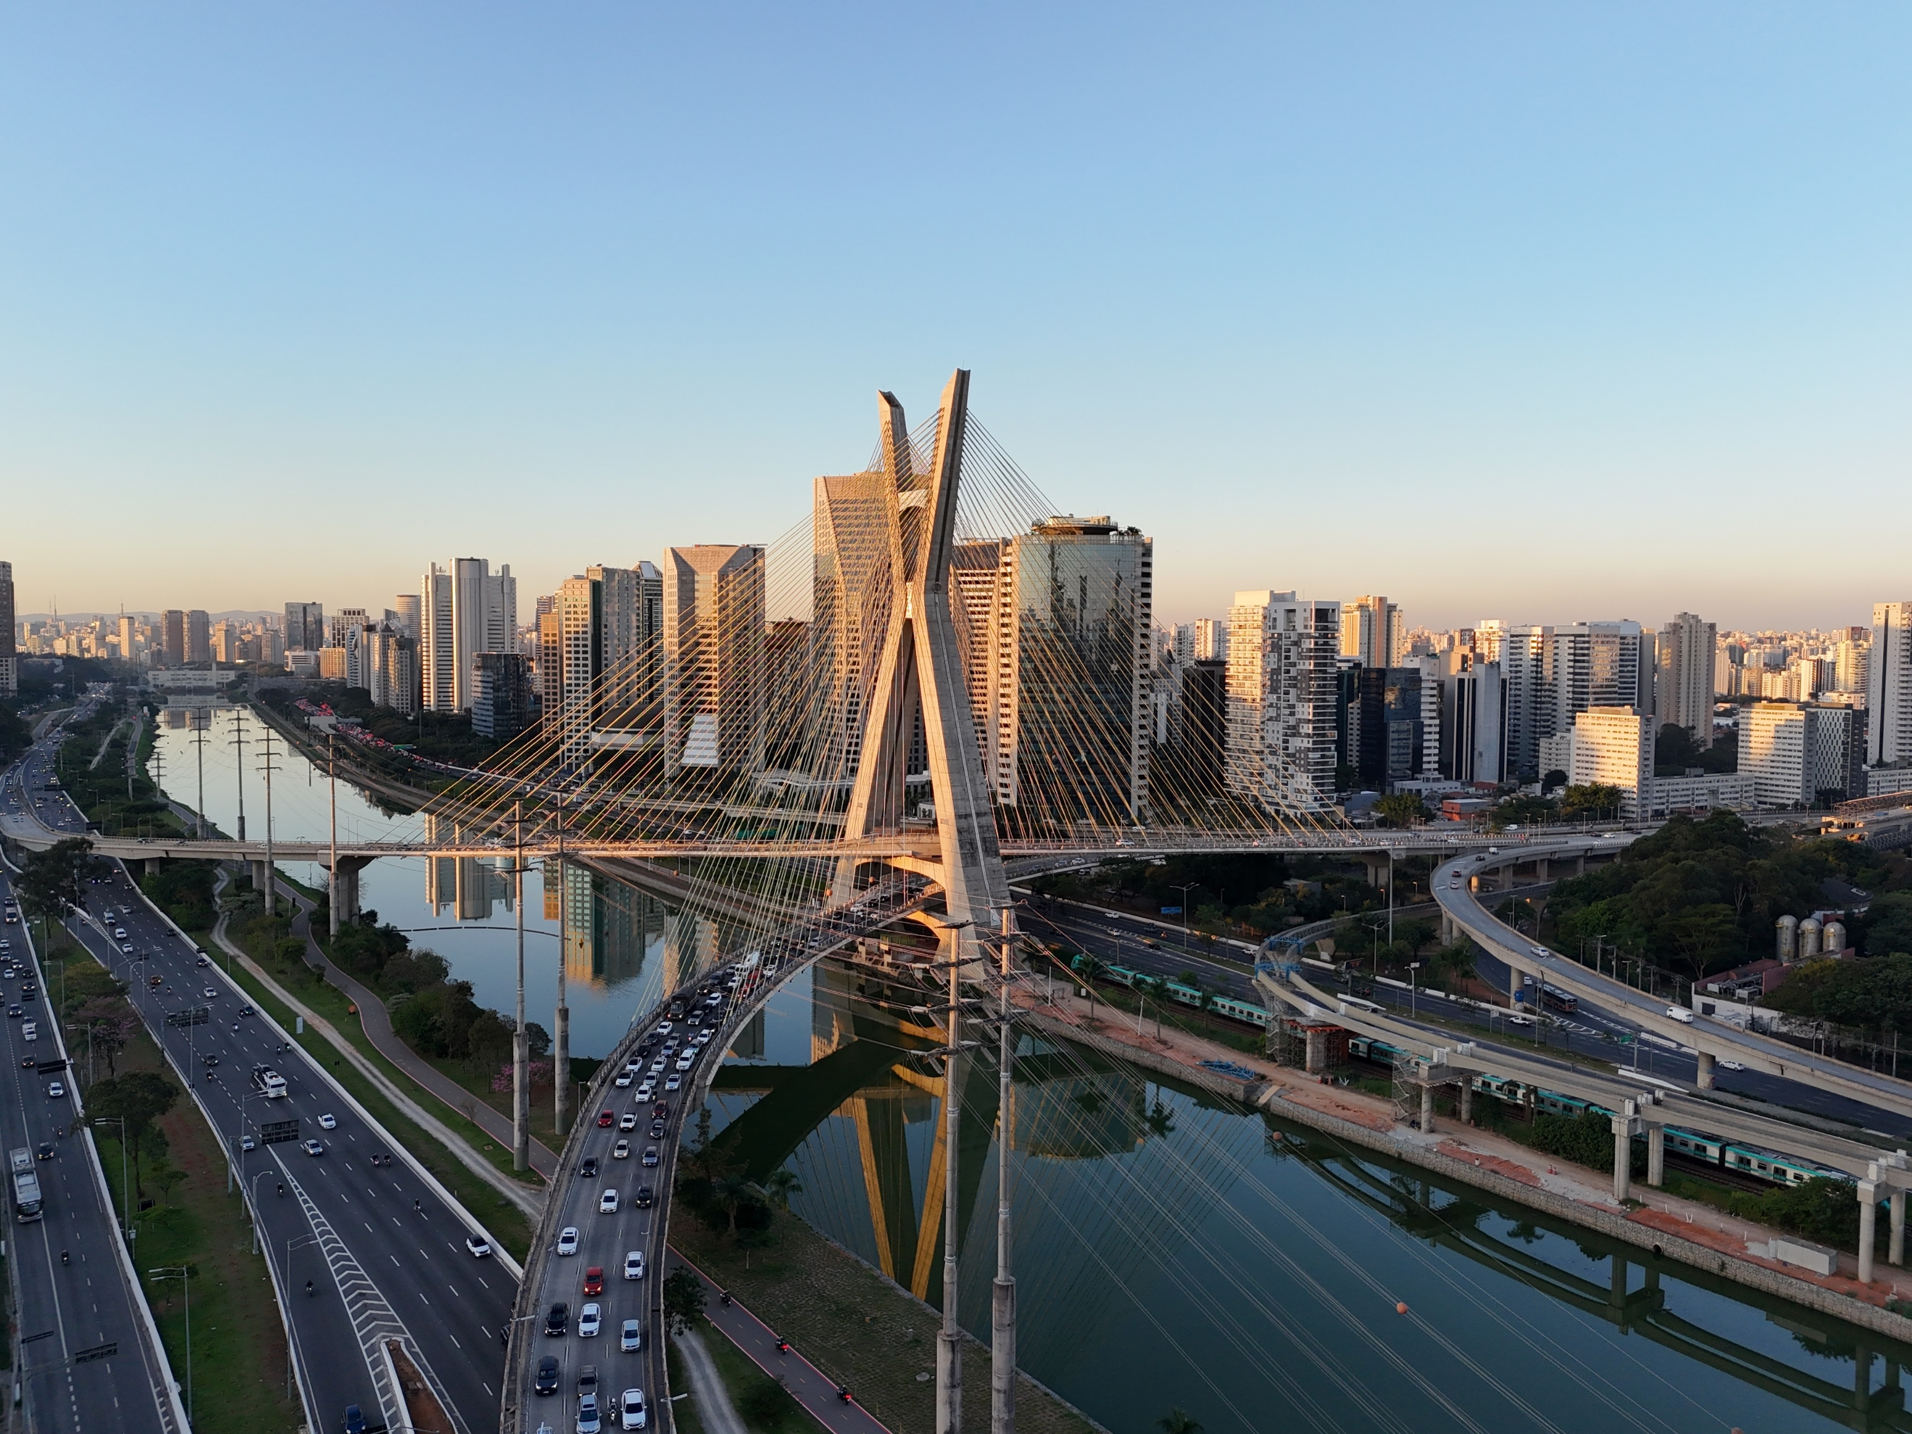
Ref 389538• SCS Pay Band 2
His Majesty's Trade Commissioner for Latin America and the Caribbean and Consul General São Paulo
Closing date: 23:55 on 23rd February 2025

Slide 2
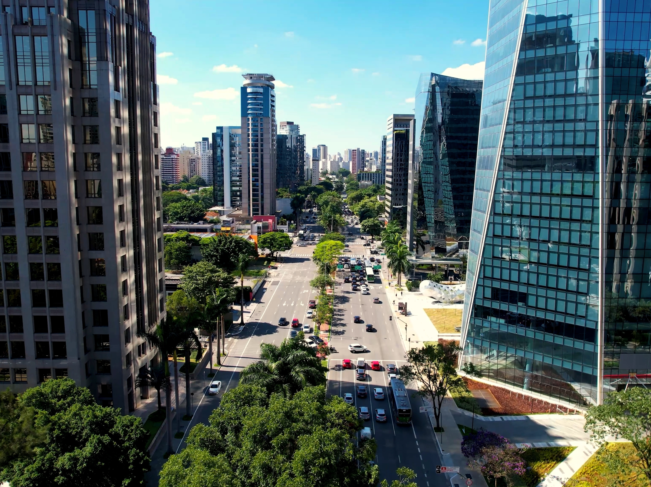
Contents
1. Salary and terms of appointment
Welcome Message, Permanent Secretary
About the Role
Key Responsibilities
Essential Criteria
Language Skills
Living in São Paulo
Campaign Timeline
How to Apply
Recruitment Process
Jonathan’s career and role as HMTC LATAC
Benefits of working for DBT
DBT Values
Diversity and Inclusion
FAQ’s
Contact Us

Slide 3
Salary and terms of appointment
Salary: £125,000 + allowances A base salary of £125,000 + suitable overseas allowances, including cost of living allowance. The amount of these allowances will be subject to an individual's circumstances e.g. the number of dependents. These allowances may cover:
Accommodation and utilities
Childcare costs including school fees
Travel to and from post
Standard Civil Service pay principles apply to existing civil servants. Candidates moving on lateral transfer would retain their basic salary, and those moving on promotion would either move to the bottom of the SCS2 pay band or receive a 10% uplift to their basic salary – whichever is greater.
Terms of Appointment
This appointment will be on a fixed term basis (or loan for existing Civil servants) for 3 years with the option of an additional year, and is available for full-time, or flexible working arrangements​.
Start Date & Location
The role will be based in the São Paulo, Brazil and is expected to commence late 2025 but start date will be dependent on completion of language training, security clearance and onboarding.
Security Clearance & Eligibility
This role requires Developed Vetting (DV) clearance, and you must hold/be willing to undertake clearance to this level.
More information on this vetting process can be found here https://www.gov.uk/guidance/united-kingdom-security-vetting-applicant.
You will only be eligible for this appointment if:
You are a British citizen; and
You have been resident in the UK for five out of the last ten years immediately prior to your application.
Please note: at least one year of this must have been a consecutive twelve-month period, unless you have served overseas with HM Forces, or in some other official capacity as a representative of His Majesty’s Government or have lived overseas as a result of your parents’ or partner’s Government Employment.
This is a reserved post: Certain posts, notably those concerned with security and intelligence, might be reserved for British citizens, but this will not normally prevent access to a wide range of developmental opportunities within the Civil Service. For further information on whether you are eligible to apply, please visit GOV.uk.
Medical clearance
All overseas appointments are subject to medical clearance being given. The FCDO Travel and Movement Services Support Group help you, and your family, move overseas.

Slide 4
Welcome Message
This is an exciting time to join the Department for Business and Trade.
We have a clear mission – to grow the economy. Our role is to help businesses invest, grow and export to create jobs and opportunities right across the country.
We do this in three ways:
Firstly, we help to build a strong, competitive business environment, where consumers are protected and companies rewarded for treating their employees properly.
Secondly, we open up international markets and ensure resilient supply chains. This can be through Free Trade Agreements, trade facilitation and multilateral agreements.
Thirdly, we work in partnership with businesses every day, providing advance, finance and deal making support to those looking to start up, invest, export and grow.
Our people are based across the UK and in over 100 countries around the world. We deliver through our 19 partner organisations including the Competition and Markets Authority, British Business Bank and the Trade Remedies Authority. We connect business and government, which is reflected in the skills and expertise of our people.
I look forward to hearing from you.
Gareth Davies,
Permanent Secretary

Slide 5
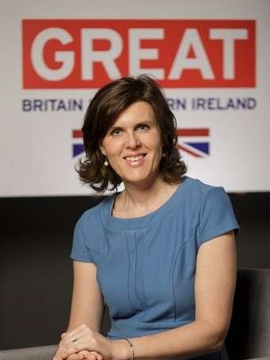
About the Role
The role of His Britannic Majesty’s Trade Commissioner (HMTC) for the Latin America and Caribbean (LATAC) region is to lead and coordinate work to grow the UK's trade with the countries of Latin America and the Caribbean. This role is at the heart of the UK’s growth mission, Industrial Strategy delivery and trade agenda. You will be accountable to the Secretary of State for Business and Trade and work with government and business to shape the UK's trade relationships with the Region, coordinating closely with Ambassadors and High Commissioners across the region and Departments in London. You will:​
Set priorities for and lead the work of your widespread regional team of circa 140 people on export promotion and investment to the UK and support work to remove market access barriers and open markets for UK business across the region;
As CG São Paulo, lead a team of circa 100 in building the relationship with Sao Paulo State and City (responsible for 30% of the country’s GDP), help to set direction and support the HMG network across Brazil;
Be a senior representative of His Majesty’s Government in the region and be responsible for building and maintaining relationships with a wide range of stakeholders at the highest level across private and public sectors. This opportunity offers breadth and profile and offers complexity, challenge, and the chance to shape the UK's future economic relationship with Latin America and the Caribbean.
It’s a big job, and one that will suit someone who wants to make a tangible difference in a fascinating context. If you are interested in increasing UK trade and investment with this vibrant part of the world, I would warmly welcome an application from you.
Joanna Crellin​
DG Domestic & International Markets and Exports

Slide 6
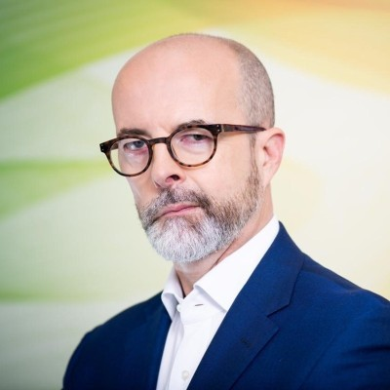
Key Responsibilities
In close cooperation with DBT HQ and Ambassadors and High Commissioners in the region, you will provide strategic direction to your teams in order to achieve maximum benefit for the UK economy;​
Lead regional policy initiatives to improve the environment in which business operates, whether tackling market access, regulatory or legislative challenges, as well as identifying strategies to unlock trade barriers in specific sectors;​
Cultivate impactful and powerful strategic relationships with major stakeholders from the UK and across the region, including: business leaders; LATAC ministers and government officials, investors; and UK Ministers and senior officials across all government departments;​
Ensure all commercial teams across the region forecast and deliver targeted export and investment programmes where there are high value opportunities maximizing leverage from UK Government; ​
Take a cross-sector view to pursue direct investment into the UK, particularly in line with current HMG strategies
Provide strategic insight, analysis and advice on pursuing an ambitious economic relationship with the LATAC region.​
Jonathan Knott
Current HMTC LATAC
Please find the link below to Jonathan’s introduction to the position of HMTC LATAC:
Link to HMTC LATAC video
Provide inspiring leadership to a team of circa 140 staff and build high performing, expert, engaged and inclusive teams; ​
As a member of DBT’s leadership team, contribute to the strategic and operational direction of the department, as well as acting as a very senior representative of HMG in the region.
HM Consul General to São Paulo, supporting delivery of the FCDO led Country Business plan; building political and commercial relationships; and undertaking representational duties to support other government departments operating on the platform.

Slide 7
Essential Criteria
Experience of successfully leading a complex, matrixed and demanding organisation, providing leadership to teams and people you do not directly manage. Experience of managing a significant budget in either the public or private sector, providing strategic prioritisation and clear evidence of empowering others to achieve organisational goals;​
Highly developed commercial acumen and judgement, with a track record of successful delivery across a variety of commercial issues and opportunities, an understanding of the issues facing businesses overseas, and experience of working with the private sector and building successful relationships;​
Strong strategy and delivery skills to develop and lead the implementation of a coherent end to end approach to export promotion, investment and trade policy, including market access issues. Excellent collaboration skills to lead the region’s trade and investment work for the whole of UK Government and across organisational boundaries;​
Proven success in working in a political and commercial environment with very senior stakeholders / VIPs showing sound judgement, diplomacy, tact and direction at all times;​
The confidence and skills to undertake public engagements, including media.​
A proven ability in learning a language but proficiency in Portuguese would be advantageous and willingness to bring this up to operational level within a year. (Please see ‘language skills’ slide for further information)

Slide 8
Language Skills
Language​
The ability to speak Portuguese is not a prerequisite to the role but candidates will be expected to have Portuguese language skills to an operational level upon arrival at post in Brazil. ​​ During the onboarding to the position, we will support you fully with the tuition needed to reach this level as a core part of your preparation and personal development.
The successful candidate will demonstrate either of the below and these should be reflected in your application:​​
a pre-existing command of Portuguese or ​​
evidence of the capability and willingness to reach the level of fluency required.​​
Our offer to you​​
If you are shortlisted for the role, you will need to undertake a language aptitude test (MLAT) ahead of your interview, which will determine your current language ability.
The test will give you a score which indicates your potential for learning the language and therefore the length of full-time language learning programme you may require, if successful.
Language programme: This can take up to 8 months, depending on your Portuguese language ability. It will ensure you are trained from beginner to C1 (Operational).​
The appointee will be expected to reach C2 (Extensive) within 12 months of taking up the post.

Slide 9
Living in São Paulo, Brazil
São Paulo, Brazil’s largest city with over 21 million people in the metropolitan area offers a vibrant and diverse cultural scene. A destination of many accolades; the biggest city in South America, the centre of the Brazilian economy, it’s home to a thriving international community, which helps fuel a dynamic, active and exciting cultural scene.
A city that embraces carnival and samba and hosts international events of all kinds, from commercial to Formula 1, and home of the world´s largest Pride event. International schools and medical care here are of a high standard. There is a fantastic selection of restaurants, many inspired by the large Japanese, Italian and Lebanese communities. It offers a high standard of living for families and individuals, having good schools and opportunities for travel and socialising, including museums, theatres, music venues and their popular large public park, Ibirapuera.
São Paulo is very busy, but the community are polite, friendly and hospitable. As very few Brazilians speak English, having a good level of Portuguese language ability is important to be able to understand and communicate on a day-to-day level. With warm summers and mild winters, São Paulo’s pleasant climate adds to its appeal, providing an excellent quality of life for those who choose to live in this vibrant Brazilian metropolis.
As Trade Commissioner and Consul General you will live in the official Residence, a modern bright house with a reception area and garden which is ideal for the representational duties which come with the job.
Our Executive partners Hays can offer more of an insight into living and working in Sao Paulo and once successful in
post you will receive an extensive pack covering further information around schooling and job opportunities for family, accommodation, travel, culture and practicalities of living there.

Slide 10
Indicative Timeline​
(In exceptional circumstances it may be necessary to alter the membership of the panel, if this happens you will be informed at the earliest opportunity)
Selection Panel
The panel will be chaired by Martin Spencer, Civil Service Commissioner and will include:
Jo Crellin, Director General, Domestic and International Markets and Exports
Stephanie Al-Qaq, Ambassador to Brazil
Ceri Smith, Director General, Office for Investment
Jackie Hart, HR Deputy Director
We will try and offer flexibility, if necessary, but it may not be possible to offer alternative dates for assessments or interviews. You are therefore expected to note the below timetable, exercising flexibility through the recruitment and selection process, in order to meet the dates given. Please note that these dates may be subject to change.​
The anticipated timetable is as follows:
23:55 on 23rd February 2025
w/c 31st March & w/c 7th April
25th April & 1st May
w/c 3rd March 2025
w/c 24th March 2025
Deadline for applications​
Longlist results expected by​
Shortlist results expected by​
Assessments & stakeholder conversations
Interviews
Please note:​
Assessments are normally conducted during UK business hours, whereas interviews are likely to take place within the business hours of the role's time zone. If you are currently based in a different time zone to the role you are applying for, we will try to accommodate this but please be aware that you may need to conduct your assessments and/or interview during unsocial hours.​

Slide 11
How to Apply
How to apply​​
Hays, an Executive Search firm, have been appointed to assist with this recruitment campaign. To apply for this post, you will need to submit documentation below via the following link, by no later than 23:55pm on 23rd February 2025:
Follow this link to apply
If you have any issues accessing the link or questions regarding the documentation, please contact:​
Andrew Timlin: 07887777735 Andrew.timlin@hays.com ​
Simon Winspear : 07525466357 Simon.winspear@hays.com​
Documentation:​
A CV setting out your career history, with key responsibilities and achievements. Please ensure you have provided reasons for any gaps within the last two years.​
2. A Supporting Statement of around two pages of A4 explaining how you meet the requirements of the person specification as far as you are able to, including your language ability for the role.
Failure to submit both documents will mean the panel only have limited information on which to assess your application against the criteria in the person specification. Please ensure that both documents contain your full name.
Your Supporting Statement
This is your opportunity to give examples and show how your skills and experience fit the job requirements.
When writing a supporting statement, it is important that you:
Read the job specification so you are clear about the job requirements. Structure your personal statement to reflect the essential criteria listed in the advert.
Make sure you provide evidence against each of the listed criteria - i.e. ‘experienced in leading high performing and diverse teams and promoting inclusivity.’ When have you led a team, how large, what did you do to promote inclusivity, how did you handle diversity?
Ensure any evidence you provide demonstrates the impact and result of your actions in that situation, provide statistical evidence where relevant.
For more information click here

Slide 12
Recruitment Process
Longlist
Longlisting is made on the basis of merit, following the closure of the advert, the panel will assess the evidence presented by all applicants against the advertised essential criteria. The highest rated applicants will be invited to a pre-liminary interview with Hays and former Deputy Trade Commissioner LATAC, Spencer Mahoney.
Shortlist
Shortlisting for interview is made on the basis of merit. The selection panel will assess the evidence presented following longlist stage and the highest rated applicants will be progressed to interview.
Assessments​​ including Language Aptitude Test
If you are shortlisted, you will be asked to take part in a series of assessments which will include a staff engagement exercise.
You will undertake a language aptitude test (MLAT) prior to interview which will determine your current language ability.
You will also be invited to speak with the current HMTC, Jonathan Knott, the Ambassador Stephanie Al-Qaq and/or Director General, Jo Crellin. As this is an optional part of the process, this will not be used as part of your assessment for the position
Full details of the assessment process will be provided to shortlisted candidates at the earliest opportunity. These assessments will not result in a pass or fail decision. Rather, they are designed to support the panel’s decision making and highlight areas for the panel to explore further at interview.
Interview​​
Shortlisted candidates will be asked to attend a panel interview in order to have a more in-depth discussion of your previous experience and professional competence in relation to the criteria set out in the essential criteria.​​
As part of the interview, you will be asked to prepare and present a short presentation, you will be advised of the presentation question in the interview invitation.
Selection and Feedback​​
Regardless of the outcome, Hays will notify all candidates as soon as possible. You will be sent a copy of any report for any assessment that you may have undergone as part of the recruitment process.​​
Feedback will only be provided to candidates who reached ​interview.​​
Reserve List​​
If we receive more applications from suitable candidates than we have vacancies at this time, we may hold suitable applicants on a reserve list for 12 months, and future vacancies requiring the same skills and experience could be offered to candidates on the reserve list without a new competition. You will be told if your application is to be held on a reserve list.
Diversity Monitoring​
As part of the online application process, you will be asked a number of diversity-related questions. If you do not wish to provide a declaration on any of the particular characteristics, you will have the option to select 'prefer not to say'.

Slide 13
Career and role as HMTC LATAC​
I am His Majesty's Trade Commissioner for Latin America and the Caribbean, based in our Consulate in São Paulo, Brazil.
Having trained as a lawyer and later a management accountant I joined the Civil Service in my twenties and enjoyed a varied career in the Foreign Commonwealth and Development Office, starting in Latin America and culminating in posts as Ambassador in Hungary and Poland. The themes running through my career being leading complex teams and supporting UK business. After those roles I was keen to find a fresh challenge and one which gave me the chance to make a real, personal contribution to the UK - and found exactly that in this Trade Commissioner job. One of the most challenging and rewarding roles I’ve had.
I love the range and combination of disciplines the role requires. Leading a big team across 18 countries, engaging with senior business people and government representatives, working in and with the media, developing policy and finding solutions to barriers to business. All this while the team grows our commercial relationships at a really impressive rate: they’ve doubled their delivery of exports and inward investment is just three years. And there’s so much more to come.
Every day is different and stimulating . The job needs a fair bit of travel and distances are pretty big. But for me that’s been part of the charm of the job – meeting ministers and business leaders in their own countries, communicating in their languages. Returning regularly to the UK to dock in with ministers and colleagues in government and to reach out to UK business and LATAC investors. Not an easy job, but a brilliant one. I thoroughly recommend it to you.
Jonathan Knott
HM Trade Commissioner for LATAC
It’s a joy to work with the enthusiastic, gifted DBT team which I’ve had around me. We’ve achieved so much together – and there’s so much still to do.
​

Slide 14
Benefits of Working for DBT​
DBT is a rewarding place to work, offering:​
Job satisfaction: an almost unparalleled opportunity to make a significant contribution to UK and economic growth. An opportunity to meet and form relationships with the most senior stakeholders in a thriving and dynamic region of the world​.
Unique and exciting roles within government​.
Competitive salaries and benefits packages: including prestigious accommodation, support staff, personal and family travel and education support​.
Learning and development opportunities​.
Flexible working options​.
Generous annual leave and bank holiday allowance​.
Civil Service Pension Scheme. Your pension is a valuable part of our reward package, with contribution rates currently up to 27.9%.
Family friendly policies including maternity, adoption or shared parental leave, available with up to 26 weeks full pay, followed by 13 weeks statutory pay and a further 13 weeks unpaid​.
2 weeks full pay available for paternity leave​.
An equal and diverse workplace​.

Slide 15
Our DBT Values​
Excellent
Connected
Our work matters. It makes a difference to people's lives across the country. We combine excellence with pace to maximise the impact we have.
We actively partner with businesses across the UK and across the world. We are accessible and we help them navigate Government, using our strong relationships to get things done.​
Our company values are essentially the fundamental beliefs that guide our organisation's decision-making and overall approach to business. They serve as the bedrock of the company culture, shaping how our employees interact with each other, stakeholders, and the wider world. Here's a breakdown of what company values are and their significance.
Confident
Collaborative
We have a distinctive perspective, informed by our work with business. We make a compelling case for what we want to do, and don't let obstacles get in the way.​
We are one department, bringing together teams from across the UK and across the world. We ensure everyone is supported and can see how their work makes a difference.​

Slide 16
Diversity and Inclusion in DBT
We are committed to inclusive and diverse leadership, and we welcome applications from under-represented groups and those based across the whole of the UK.
To learn more please see the Civil Service People Plan and Civil Service D&I Strategy.
We treat everyone openly, fairly and equally, and we collaborate proactively with a can-do attitude, inspiring others to want to engage with us. We respect each other's views regardless of background, and we do not discriminate. We are one department, we have a shared culture across our diverse, global organisation. We celebrate our diversity of thought, coming from different backgrounds, places and experiences to deliver the best for the UK, our markets and our customers. And we are better for it.
Staff Networks
With a multitude of networks, there's something for EVERYONE. Our networks support equality and showcase examples of inclusivity across the organisation. Each one has a senior champion to ensure they are heard at the top of the organisation.
Our networks pride themselves on working together, getting under the skin of intersectionality, championing allyship and education. Turning these collaborations into action plans which lead to real change.
Reasonable Adjustments
The Department is recognised as a Disability Confident Leader. Please follow this link for information.
We are committed to attracting, recruiting and retaining disabled people and supporting them in achieving their full potential.
If you need a change, or what we call a reasonable adjustment, to be made so that
you can make your application, you should contact Andrew.timlin@hays.com or Simon.winspear@hays.com as soon as possible before the closing date to discuss your needs.
Furthermore, we are also able to offer reasonable adjustments throughout the recruitment process at assessment and interview stage. For example, this may be a consideration around wheelchair access at interview, or adjustments for neurodiversity (e.g. ADHD, autism, dyslexia or dyspraxia) when extra time can be offered for written tests or alterations to the environment in which you’re interviewed.

Slide 17
FAQs
7. What do I do if I want to make a complaint?​
The law requires that selection for appointment to the Civil Service is on merit on the basis of fair and open competition as outlined in the Civil Service Commission’s Recruitment Principles.
If you feel your application has not been treated in accordance with the Recruitment Principles and you wish to make a complaint, you should contact Georgia Defoe SCSrecruitment@businessandtrade.gov.uk in the first instance.
If you are not satisfied with the response you receive from the Department, you can contact the Civil Service Commission at: https://civilservicecommission.independent.gov.uk/contact-us/
8. What should I do if I think I have a conflict of interest?
Candidates must note the requirement to declare any interests that might cause questions to be raised about their approach to the business of the Department. If you believe that you may have a conflict of interest, please contact Andrew Timlin, Andrew.timlin@hays.com or Simon Winspear, Simon.winspear@hays.com before submitting your application.
9. I am currently on pre-modernized terms and conditions, can I retain these terms and conditions, including annual leave allowance, if I am offered and accepted this role?
Staff promoted into or within the Senior Civil Service on or after 1st July 2013 will be automatically moved to modernised terms and conditions as per the Civil Service Management Code. Staff moving on lateral transfer can retain their current T&Cs.
Please visit https://www.gov.uk/government/publications/civil-servants-terms-and-conditions
1. Can I apply if not currently a Civil Servant?​
Yes. This role is open to suitably qualified people in the external market and to existing civil servants and those in accredited Non-Departmental Bodies.​
2. Is this role suitable for part-time working?​
This role is available for full-time, or flexible working arrangements. If you wish to discuss your needs in more detail, please get in touch.
3. Is this role reserved for UK Nationals?
Yes, this is a reserved post. Certain posts, notably those concerned with security and intelligence, might be reserved for British citizens, but this will not normally prevent access to a wide range of developmental opportunities within the Civil Service.​​
4. Will the role involve travel?​​
Yes, you will be primarily based in region, with regular travel throughout the region and to the UK required.
5. Where will the role based?​
If successful you will be based in São Paulo, Brazil.
6. Can I claim back any expenses incurred during the recruitment process?​
No, unfortunately we will not be able to reimburse you, except in exceptional circumstances and only when agreed in advance.

Slide 18
FAQs – Security Clearance & Eligibility
Security Clearance and eligibility:
This role requires Developed Vetting (DV) clearance, and you must hold/be willing to undertake clearance to this level. You should be aware that a lack of sufficient background information may preclude you from being granted security clearance​​.
If you hold dual nationality (i.e. you are a British citizen and are also a national of another country) this should not preclude you from applying; however, it is your responsibility to check if this places any personal, financial or other obligation on you if posted to a job in the other country whose nationality you hold. ​
The qualifying criteria needed to apply for DV:​
A resident in the UK for five out of the last ten years immediately prior to your application. Please note: at least one year of this must have been a consecutive twelve-month period, unless you have served overseas with HM Forces, or in some other official capacity as a representative of His Majesty’s Government or have lived overseas as a result of your parent’s or partner’s Government employment. ​
For more information about the clearance and vetting process, please go to: https://www.gov.uk/guidance/united-kingdom-security-vetting-applicant
Country Clearance:
Having DV clearance alone is not sufficient for Overseas postings and country clearance needs to be requested from DBT Personnel Security, after obtaining DV.
Having security clearance does NOT mean having country clearance and/or is not an indication country clearance will be granted. There are circumstances that may impact you being granted the required country clearance. Your situation (known through your vetting records) may affect your post/department's ability to manage the risk to you at post and may prevent awarding the country clearance for the role. Each request is reviewed individually on its own merit.
Candidates with close links of heritage with the country/region where they are applying to work should be aware that security considerations will apply in relation to the DBT's duty of care to you (and your family), which may result in DBT needing to withdraw the offer of employment.
Applicants who wish to understand more about the country clearance are advised to contact the DBT Vetting Team (Vetting@businessandtrade.gov.uk), attaching the job specification from this advert and a summary of your concerns or query.

Slide 19
Thank You
If you wish to discuss the role in more detail before submitting an application, please contact Hays Executive on:​
Our work is governed by the Civil Service Commission
Andrew.timlin@hays.com or Simon.winspear@hays.com
​

