Slide 1







Ref 4807605• SCS Pay Band 2
Director, Services
Closing date: 23:55 on 19/07/2026

Slide 2

Contents
  Welcome Message, Permanent Secretary
  About DBT
  Our DBT Values
  Terms of Appointment
  About the Role
  Key Responsibilities
  Essential Criteria
  Campaign Timeline
  How to Apply
  Recruitment Process
  Benefits of Working for DBT
  Diversity and Inclusion
  FAQs
  Contact Us

Slide 3
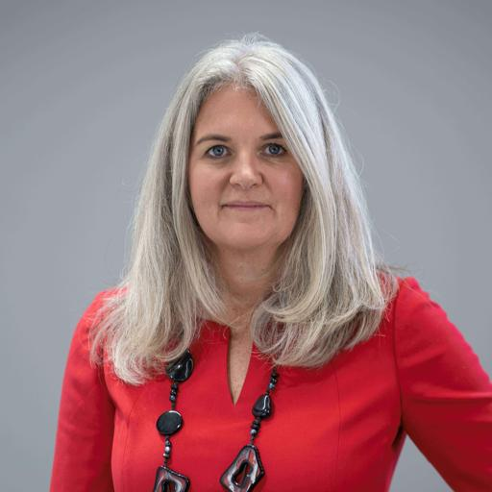
Welcome Message
This is an exciting moment to join the Department for Business and Trade.
Thank you for your interest in this important leadership role in DBT. Our mission is economic growth: supporting businesses to invest, export and grow, creating jobs and opportunity across the UK.
We are now focused on turning that mission into delivery, with refreshed clarity on our priorities, confidence in how we work, and pace in what we achieve.
Our priorities are to:
Make the UK the best place in the world to do business
Make the UK the best‑connected economy
Deliver great services for business
Amanda Brooks
Interim Permanent Secretary
As a Senior Civil Service leader, you play a critical role in delivering this, driving impact, shaping high‑performing teams, and staying closely connected to business. Our shared behaviours define how we work:
Getting Stuff Done: focus on delivery and impact
Keeping Learning: build capability and continuously improve
Having a View: act with confidence, grounded in insight
You join at a point where your leadership will help shape the next phase of DBT.
I am looking forward to working with you.

Slide 4

About the
Department for Business and Trade​
What we do?
We bring together business leaders and trade experts to make the UK a thriving business hub. Our network of 20 partner organisations, from the Fair Work Agency to the British Business Bank, supports businesses domestically and internationally. We connect businesses to government, attract investors, and unlock exports through trade deals. Our UK-based staff empowers colleagues in over 100 countries. With offices in London, Darlington, and across the UK, we're here to help businesses succeed.

Slide 5


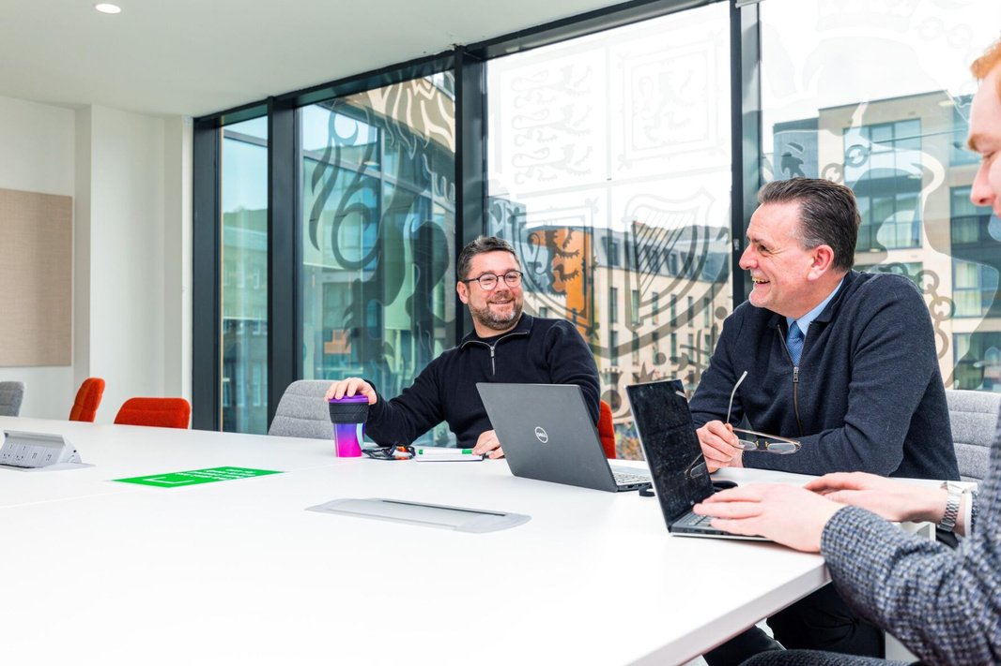


Our DBT Values​
Excellent
Connected
Our work matters. It makes a difference to people's lives across the country. We combine excellence with pace to maximise the impact we have.
We actively partner with businesses across the UK and across the world. We are accessible and we help them navigate Government, using our strong relationships to get things done.​
Our company values are essentially the fundamental beliefs that guide our organisation's decision-making and overall approach to business. They serve as the bedrock of the company culture, shaping how our employees interact with each other, stakeholders, and the wider world. Here's a breakdown of what company values are and their significance.
Confident
Collaborative
We have a distinctive perspective, informed by our work with business. We make a compelling case for what we want to do, and don't let obstacles get in the way.​
We are one department, bringing together teams from across the UK and across the world. We ensure everyone is supported and can see how their work makes a difference.​

Slide 6
Terms of appointment
Salary:
The SCS2 salary band is £100,000 - £162,500.
Standard Civil Service pay principles apply to existing civil servants. Candidates moving on lateral transfer would retain their basic salary, and those moving on promotion would either move to the bottom of the SCS2 pay band or receive a 10% uplift to their basic salary – whichever is greater.
Contract Type:
This appointment will be on a permanent basis. This role has a minimum assignment duration of 3 years. This is an expectation only; it is not something which is written into your terms and conditions or indeed which the employing organisation or you are bound by. It is available for fulltime or flexible working arrangements reflected by the needs of the role (including pre-existing job share partnerships).
Location & Travel:
The role is UK-based, in London, Belfast, Birmingham, Cardiff, Darlington, Edinburgh or Salford (the Salford location will change to Manchester in 2027). Some domestic/international travel will be required (c. 20-25 days per year).
Office Attendance:
DBT operates a hybrid working model and, you will be required to work a minimum of 60% of your contracted hours (averaged over the month) in the office. The majority of the team is based in London so about two days a week would need to be in London to provide team and Ministerial support.
Security Clearance & Eligibility
This role requires Security Clearance (SC) and you must hold/be willing to undertake clearance to this level. You will not be able to start in the post until you have clearance in place.
This is not a reserved post.
Certain posts, notably those concerned with security and intelligence, might be reserved for British citizens, but this will not normally prevent access to a wide range of developmental opportunities within the Civil Service.​​
The qualifying criteria needed to apply for ﻿SC:​
A resident in the UK for three out of the last five years immediately prior to your application. Please note: at least one year of this must have been a consecutive twelve-month period, unless you have served overseas with HM Forces, or in some other official capacity as a representative of His Majesty’s Government, or have lived overseas as a result of your parent’s or partner’s Government employment.
For further information on whether you are eligible to apply, please ensure you visit GOV.uk.

Slide 7
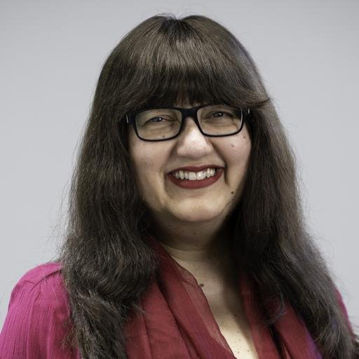
About the Role
Insert photo of DG or Director
The Department for Business and Trade promotes UK trade, investment and economic growth across key sectors. The Services Directorate leads work across a range of sectors including professional business services; retail and hospitality; agriculture, food and drink; international education, etc.
The Director for Services is a senior leadership role within Business Group, reporting to the Director General. The postholder is responsible for setting strategic direction and delivering policy, trade and investment activity across the Services portfolio, working closely with Ministers, Whitehall partners, foreign Government officials and diverse industry leaders. This is a high-profile role with responsibility for supporting the services sectors to grow, shaping the policy environment and leading engagement with senior stakeholders to strengthen the UK’s position as a global leader across Services sectors.
Jaee Samant
Director General, Business Group

Slide 8
Key Responsibilities
Lead an excellent directorate (c. 65 colleagues) which should be the centre of expertise for DBT’s Services portfolio, to drive trade, investment and policy outcomes that support UK economic growth.
Drive strategic engagement with industry and build senior relationships across DBT, Whitehall, the overseas network and international partners, working closely with business leaders and representative bodies to inform priorities, delivery, and act as a trusted ambassador for DBT and UK services sectors.
Shape domestic and international policy and regulatory frameworks, working closely with HM Treasury and partner departments such as DCMS, DfE, FCDO, HO and Defra, to maximise economic impact and ensure the growth agenda is integrated into policy development across HMG.
Develop and deliver sector strategies, campaigns and initiatives, aligned to cross-government growth objectives, especially Industrial strategy and trade strategy priority areas, directed towards strengthening global competitiveness and driving growth.
Oversee international engagement and investment activity, including trade missions, major events, global campaigns to unlock opportunities.
Ensure strong governance, ministerial engagement and team leadership, overseeing programmes, convening secretariat functions for sector councils and stakeholder interactions while setting clear direction for a high-performing, dispersed team and growth.
Be an effective member of DBT’s Senior Civil Service and of Business Group’s senior team.

Slide 9
Essential Criteria
  Senior Leadership: A visible, credible and inspiring leader with experience leading large, complex and geographically dispersed teams, fostering an inclusive, high-performance culture.
  Strategic Thinking: Strong intellectual capability with the ability to interpret data and evidence, shape strategy and lead delivery across a broad and complex policy and operational landscape.
  Delivery at Pace: A proven track record of delivering high impact outcomes, with the ability to prioritise effectively, make decisions in ambiguity and respond to emerging challenges.
  Stakeholder Engagement, Influence and Collaboration: Excellent communication and influencing skills, with a strong track record of engaging senior stakeholders and decision-makers (e.g. ministers, executives or board level leaders) and working across organisational boundaries (including government, private or third sector environments), building trusted relationships to deliver results.
  Sector and Commercial Insight: Experience working closely with business and industry, with a strong understanding of economic drivers and factors affecting growth, trade and investment and working with one or more services sectors such as professional and business services, consumer sectors, etc.

Slide 10
Indicative Timeline​
Selection Panel
The panel will be chaired by Stephen Cohen Civil Service Commissioner and will include:
Jaee Samant - DG Business, Hiring Manager
Emma Ward - DG, Strategy and Major Events (DCMS)
(In exceptional circumstances it may be necessary to alter the membership of the panel, if this happens you will be informed at the earliest opportunity)
We will aim to offer flexibility where possible, however, alternative interview dates may not be available. Please review the timetable below and ensure you can accommodate the dates provided throughout the recruitment and selection process. Note that interview dates may be subject to change.
Assessments are pre‑booked and cannot be rescheduled.
Please make sure you are available on the dates listed below
The anticipated timetable is as follows:
14:00-14:45
10th July
23:55 19th July
29th July
18th August
Staff Engagement Exercise
26th & 27th August
8th & 10th September
Candidate Information Session​
Deadline for applications​
Longlist results expected by​
Shortlist results expected by​
Assessments & stakeholder conversations
In Person Interviews
Please note:​
Assessments are normally conducted during UK business hours, whereas interviews are likely to take place within the business hours of the role's time zone. If you are currently based in a different time zone to the role you are applying for, we will try to accommodate this but please be aware that you may need to conduct your assessments and/or interview during unsocial hours.​

Slide 11
How to Apply
Your Supporting Statement
The supporting statement is your opportunity to give examples and show how your skills and experience fit the job requirements.
When writing a supporting statement, it is important that you:
  Read the job specification so you are clear about the job requirements. Structure your personal statement to reflect the essential criteria listed in the advert.
  Make sure you provide evidence against each of the listed criteria - i.e. ‘experienced in leading high performing and diverse teams and promoting inclusivity.’ When have you led a team, how large, what did you do to promote inclusivity, how did you handle diversity?
  Ensure any evidence you provide demonstrates the impact of your actions in that situation, provide statistical evidence where relevant.
For more information click here
How to apply​​​
Hays, an Executive Search firm, have been appointed to assist with this recruitment campaign. To apply for this post, you will need to submit documentation below via the following link, by no later than
23:55PM 19th July 2026.
​
LINK TO APPLY ON HAYS WEBSITE
​
If you have any issues accessing the link or questions regarding the documentation, please contact:​​
​
Andrew Timlin: 07887777735 Andrew.timlin@hays.com ​​
Owen Quant: 07867695217 Owen.quant@hays.com​​
​
Documentation:​​
​
A CV setting out your career history, with key responsibilities and achievements. Please ensure you have provided reasons for any gaps within the last two years.​​
A Supporting Statement of around two pages of A4 explaining how you meet the requirements of the person specification as far as you are able to, including your language ability for the role.​
Failure to submit both documents will mean the panel only have limited information on which to assess your application against the criteria in the person specification. Please ensure that both documents contain your full name.
Guidance on the use of AI
Please review the guidance at Artificial intelligence and recruitment | Civil Service Careers to understand the acceptable use of AI for your application.
Before you submit an application, we will ask you to confirm the information you provide is true and accurate. More details about this will be provided in the application form and we may reject applications where AI is used inappropriately at any stage of the process.

Slide 12
Recruitment Process
Candidate Information Call
The hiring manager for this position; Jaee Samant, will be hosting a virtual call for any interested applicants to discuss the role and answer any questions. Please note this is not part of the formal assessment process.
This will be held via Microsoft Teams on 10th July at 14:00-14:45 (UK time).
Please click here for the meeting link.
If you would like to join without your full name being displayed in the meeting, please ensure you access the link on a personal device and select 'Join without signing in'.
Shortlist​
Shortlisting for interview is made on the basis of merit. The selection panel will assess the evidence presented by all applicants against the advertised essential criteria and the highest rated applicants will be invited to interview.
Assessments
If you are shortlisted, you will be asked to take part in a series of assessments which will include psychometric tests and a staff engagement exercise. These assessments will not result in a pass or fail decision. Rather, they are designed to support the panel’s decision making and highlight areas for the panel to explore further at interview.
Further details on what the assessments will entail, can be found here:
www.scs-assessments.co.uk. Full details of the assessment process will be provided to shortlisted candidates at the earliest opportunity.
Shortlisted candidates will also have the opportunity to speak to Jaee Samant prior to the final interview to learn more about the role and the organisation. Please note this is not part of the formal assessment process.
Interview
Shortlisted candidates will be asked to attend a face-to-face panel in London in order to have a more in-depth discussion of your previous experience and professional competence in relation to the criteria set out in the essential criteria.
As part of the interview, you will be asked to prepare and present a short presentation, you will be advised of the presentation topic in the interview invitation.
Selection and Feedback
Regardless of the outcome, we will notify all candidates as soon as possible. We will send you a copy of any report for any assessment that you may have undergone as part of the recruitment process.
Feedback will only be provided to candidates who reached interview.
Reserve List
If we receive more applications from suitable candidates than we have vacancies at this time, we may hold suitable applicants on a reserve list for 12 months, and future vacancies requiring the same skills and experience could be offered to candidates on the reserve list without a new competition. We will contact you to confirm if your application is to be held on a reserve list.
Diversity Monitoring
As part of the online application process, you will be asked a number of diversity-related questions. If you do not wish to provide a declaration on any of the particular characteristics, you will have the option to select 'prefer not to say'. The information you provide when submitting your application will help us monitor our progress towards the Civil Service becoming the most inclusive employer.

Slide 13

Benefits of Working for DBT​
DBT is a rewarding place to work, offering:​
Generous annual leave and bank holiday allowance​.
Civil Service Pension Scheme. Your pension is a valuable part of our reward package, with contribution rates currently up to 28.97%.
Family friendly policies including maternity, adoption or shared parental leave, available with up to 26 weeks full pay, followed by 13 weeks statutory pay and a further 13 weeks unpaid​.
2 weeks full pay available for paternity leave​.
An equal and diverse workplace​.
Season Ticket Loan and Cycle to Work Scheme
Job satisfaction: an almost unparalleled opportunity to make a significant contribution to UK and economic growth. An opportunity to meet and form relationships with the most senior stakeholders in a thriving and dynamic region of the world​.
Unique and exciting roles within government​.
Competitive salaries and benefits packages: including prestigious accommodation, support staff, personal and family travel and education support​.
Learning and development opportunities​.
Flexible working options​.

Slide 14

Diversity and Inclusion in DBT
We are committed to inclusive and diverse leadership, and we welcome applications from under-represented groups and those based across the whole of the UK.
To learn more please see the Civil Service People Plan and Civil Service D&I Strategy.
We treat everyone openly, fairly and equally, and we collaborate proactively with a can-do attitude, inspiring others to want to engage with us. We respect each other's views regardless of background, and we do not discriminate. We are one department, we have a shared culture across our diverse, global organisation. We celebrate our diversity of thought, coming from different backgrounds, places and experiences to deliver the best for the UK, our markets and our customers. And we are better for it.
Staff Networks
With a multitude of networks, there's something for EVERYONE. Our networks support equality and showcase examples of inclusivity across the organisation. Each one has a senior champion to ensure they are heard at the top of the organisation.
Our networks pride themselves on working together, getting under the skin of intersectionality, championing allyship and education. Turning these collaborations into action plans which lead to real change.
Reasonable Adjustments
The Department is recognised as a Disability Confident Leader. Please follow this link for information.
We are committed to attracting, recruiting and retaining disabled people and supporting them in achieving their full potential.
If you need a change, or what we call a reasonable adjustment, to be made so that
you can make your application, you should contact SCSRecruitment@businessandtrade.gov.uk as soon as possible before the closing date to discuss your needs.
Complete the “Assistance required” section in the “Additional Requirements” page of your application form to tell us what change or help you might need further on in the recruitment process. For instance, you may need wheelchair access at interview, or if you have a form of neurodivergence (e.g. ADHD, autism, dyslexia or dyspraxia) you may need extra time to take written tests or adjustments to the environment in which you’re interviewed.

Slide 15
FAQs
1. Can I apply if not currently a Civil Servant?​
Yes. This role is open to suitably qualified people in the external market and to existing civil servants and those in accredited Non-Departmental Bodies.
2. Can I claim back any expenses incurred during the recruitment process?​
No. Unfortunately we will not be able to reimburse you, except in exceptional circumstances and only when agreed in advance.​
3. What do I do if I want to make a complaint?
The law requires that selection for appointment to the Civil Service is on merit on the basis of fair and open competition as outlined in the Civil Service
Commission’s Recruitment Principles.
If you feel your application has not been treated in accordance with the Recruitment Principles and you wish to make a complaint, you should contact Georgia Defeo (at SCSRecruitment@businessandtrade.gov.uk) in the first instance.
If you are not satisfied with the response you receive from the Department, you can contact the Civil Service Commission at: https://civilservicecommission.independent.gov.uk/contact-us/
4. Are there any additional support or schemes available to candidates applying for this role?
The Civil Service embraces diversity and promotes equal opportunities. As such, we run a Disability Confident Scheme (DCS) for candidates with disabilities who meet the minimum selection criteria.
The Civil Service also offers a Redeployment Interview Scheme to civil servants who are at risk of redundancy, and who meet the minimum requirements for the advertised vacancy.
5. What reasonable adjustments can be made if I have a disability?
We are committed to making reasonable adjustments in order to support disabled job applicants and ensure that you are not disadvantaged in the recruitment and assessment process.
If you feel that you may need a reasonable adjustment to be made, or you would like to discuss your requirements in more detail, please contact SCSRecruitment@businessandtrade.gov.uk in the first instance.
6. What should I do if I think that I have a conflict of interest?
Candidates must note the requirement to declare any interests that might cause questions to be raised about their approach to the business of the Department. If you believe that you may have a conflict of interest, please contact Georgia Defeo (SCSRecruitment@businessandtrade.gov.uk) before submitting your application.
​

Slide 16


Thank You
If you wish to discuss the role in more detail before submitting an application, please contact the SCS Recruitment Team on:​
Our work is governed by the Civil Service Commission
SCSRecruitment@businessandtrade.gov.uk ​

