Slide 1








Ref • SCS Pay Band 1
Deputy Director Place
Closing date: 23:55 on 09.11.25

Slide 2

Contents
  Welcome Message, Permanent Secretary
  About DBT
  Our DBT Values
  About the Directorate/Group
  Key Responsibilities
  Essential Criteria & Salary
  Campaign Timeline
  How to Apply
  Recruitment Process
  Benefits of Working for DBT
  Diversity and Inclusion
  SCS Career Journey Story
  FAQs
  Contact Us

Slide 3
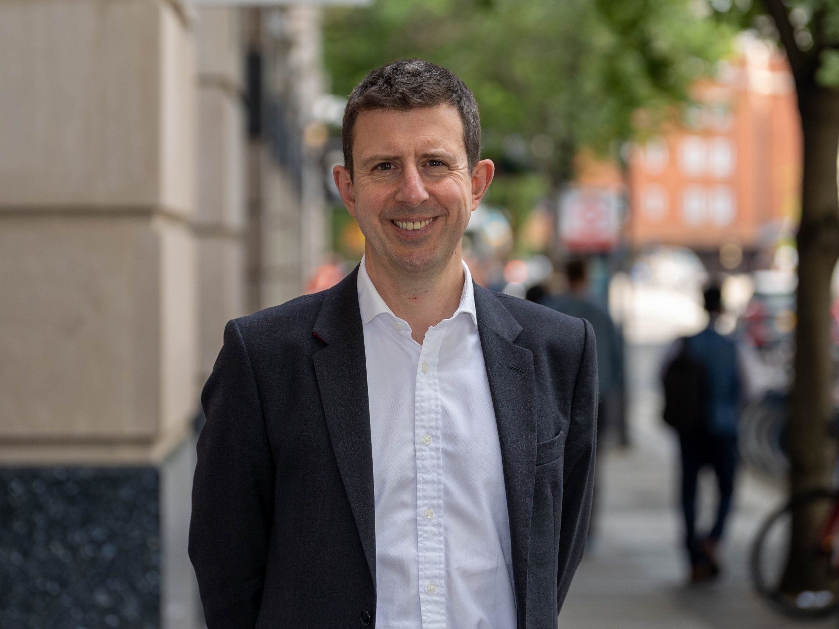
Welcome Message
This is an exciting time to join the Department for Business and Trade.
We have a clear mission – to grow the economy. Our role is to help businesses invest, grow and export to create jobs and opportunities right across the country.
We do this in three ways:
Firstly, driven by the industrial strategy we help to build a strong, competitive business environment, where consumers are protected and companies rewarded for treating their employees properly.
Secondly, we open up international markets and ensure resilient supply chains. This can be through the trade strategy, Free Trade Agreements, trade facilitation and multilateral agreements.
Thirdly, we work in partnership with businesses every day, providing advice, finance and deal making support to those looking to start up, invest, export and grow.
Our people are based across the UK and around the world. We deliver through our 19 partner organisations including the Competition and Markets Authority, British Business Bank and the Trade Remedies Authority. We connect business and government, which is reflected in the skills and expertise of our people.
I look forward to hearing from you.
Gareth Davies,
Permanent Secretary

Slide 4

About the
Department for Business and Trade​
What we do?
We bring together business leaders and trade experts to make the UK a thriving business hub. Our network of 19 partner organizations, from the British Business Bank to the Pubs Code Adjudicator, supports businesses domestically and internationally. We connect businesses to government, attract investors, and unlock exports through trade deals. Our UK-based staff empowers colleagues in over 100 countries. With offices across the UK, we're here to help businesses succeed.

Slide 5


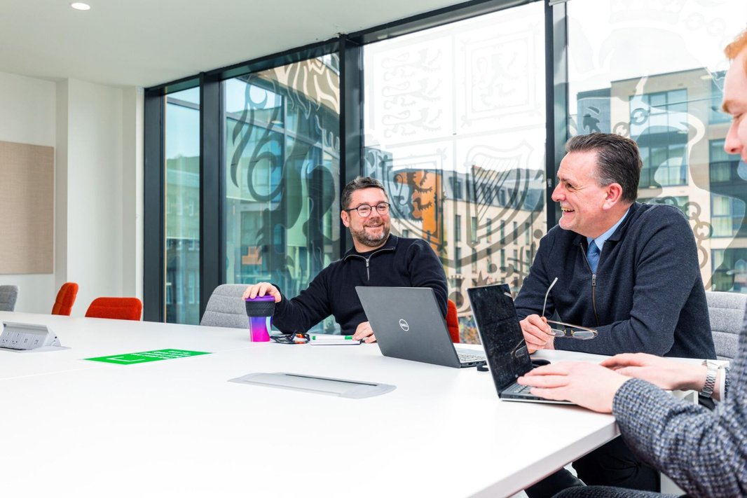


Our DBT Values​
Excellent
Connected
Our work matters. It makes a difference to people's lives across the country. We combine excellence with pace to maximise the impact we have.
We actively partner with businesses across the UK and across the world. We are accessible and we help them navigate Government, using our strong relationships to get things done.​
Our company values are essentially the fundamental beliefs that guide our organisation's decision-making and overall approach to business. They serve as the bedrock of the company culture, shaping how our employees interact with each other, stakeholders, and the wider world. Here's a breakdown of what company values are and their significance.
Confident
Collaborative
We have a distinctive perspective, informed by our work with business. We make a compelling case for what we want to do, and don't let obstacles get in the way.​
We are one department, bringing together teams from across the UK and across the world. We ensure everyone is supported and can see how their work makes a difference.​

Slide 6
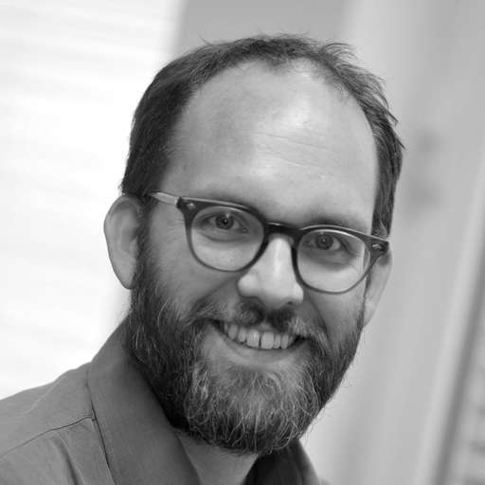

About the Office for Investment (OFI)
Increasing investment, both foreign and domestic, is crucial to the UK’s economic growth and the future prosperity of its citizens. Leveraging private investment is also fundamental to delivering new infrastructure, the energy transition and retaining international leadership as a science and technology driven economy.
The Office for Investment (OfI) was spun out of Downing Street in January 2021 and is now a joint unit between No.10, His Majesty’s Treasury (HMT) and the Department for Business and Trade (DBT). The OfI is an exciting, creative and dynamic place to work among a motivated and driven team with both commercial and public sector backgrounds. The Office works closely with Secretaries of State, Junior Ministers, and No.10 to deliver the highest-value, highest profile investment propositions.
The team operates a flexible and flat structure which means that staff across all grades have the opportunity to work directly alongside the senior leadership and have direct exposure to ministers and senior business executives.
OfI's vision and mission is to secure investment to drive growth, job creation and increased productivity across the UK. We are proactive and entrepreneurial, delivering ambitious outcomes aligned to the Industrial Strategy and HMG Missions. To become a centre of excellence for attracting and growing investment we want to attract talented people from the private sector and across government – local and national - who are curious, creative and agile in pursuing emerging opportunities for the UK.
This is a wide-ranging role where you will get to develop new skills and build on existing ones to increase investment opportunities and shape the wider Government policies investors will operate under.
Ceri Smith
Director General, Office for Investment

Slide 7

Key Responsibilities
This role will deliver the OfI’s regional strategy, reporting to the Director. You will be responsible for building strong relationships with regional leaders (First Ministers, Mayors etc), C-suite investors, and other government departments, to deliver transformational investment projects and develop high-quality, high-impact, large-scale investment opportunities across the UK. You will be expected to play a leadership role within the OfI as a member of the Senior Leadership Team, as well as line-management responsibilities for the OfI’s Investment Partners (Grade 6) in the regions and nations.
Key areas of responsibility include:
Regional Opportunities: You and your team will work develop a pipeline of transformational local investment opportunities and work with partners across the UK to surface and co-design products to meet global corporate and capital demand. You will draw in experts from across OfI (especially Product team), government and industry to help structure and market these opportunities.
Regions and nations network: You will be well-networked and visible as a leader across the UK regions and nations, working hand in glove with First Ministers, mayors, local authorities, and other leaders to ensure that large-scale opportunities are brought to market effectively, including by unblocking barriers to delivery. You will utilise the Council of Regions & Nations, Executive Forum and drive the Investment Sub Group for Chief Executives to achieve investment outcomes. You will empower your Grade 6’s to have senior relationships across their dedicated region and support them to develop powerful networks to help identify and deliver deals.

Slide 8
Key Responsibilities continued
Investor Relations: You will nurture and manage relationships with senior decision-makers in the world’s leading companies. You will provide trusted advice, make introductions to No10 and Ministers, and help them navigate the complexities of the UK system. You will also set direction within HMG, providing leadership to teams brought together from relevant departments
and delivery partners to unblock barriers.
Investment Strategy: You will provide expert, commercially astute advice to No10, HM Treasury and other departments on how to unlock investment to operationalise the Government’s strategies. You will engage industry, investors, academics, and policy experts in other departments to understand market demand, failures, barriers, and opportunities across critical supply chains, applying an investor-focused lens to spot gaps and, where needed, challenge the direction of HMG’s approach.
Deal Closure: You will focus intensively on landing a very select number of the most strategically important investment projects, convening and corralling wider OfI teams and departments to ensure that all the relevant HMG levers, direct and indirect, are pulled to get deals over the line. For some projects you will be responsible for championing their strategic importance and proactively securing the mandate to devote focus and drive to them.
Team management: You will oversee a team of circa 15, G6s, G7s and SEOs operating across the UK, ensuring that the team is well directed, with clear roles, responsibilities and both short and long-term priorities, to ensure strong delivery. You will also drive strong collaboration with other teams, such as Deal Makers, Product, Marketing and Investor Relations, so that OfI’s regional offer feels seamless to external stakeholders, and the regional agenda is well represented internally.

Slide 9


Essential Criteria
A proven understanding of, and ability to navigate, the regional landscape, working collaboratively with local leaders and government.
An effective and inspirational leader with a track record of building and motivating geographically dispersed teams​.
Experience working with investors, applying commercial acumen and an understanding of how investors make decisions​ and how to create compelling investment propositions.
Self-starter with the confidence and entrepreneurialism to build networks and relationships with a wide range of key stakeholders across the public and private sector, ideally already having extensive investment networks across the public, private sector, and the advisory community.
A strategic thinker with a high level of intellectual energy, skilled at drawing on socio-economic, commercial, and political insights to shape the direction for an organisation and wider partners​.
Excellent written and oral communication skills with an ability to influence and persuade different audiences, including senior leaders.​
Salary £81,000 - £117,800
This role has a minimum assignment duration of 3 years. This is an expectation only; it is not something which is written into your terms and conditions or indeed which the employing organisation or you are bound by. ​
Standard Civil Service pay principles apply to existing civil servants: Those applying on promotion will receive either a 10% increase of their current basic salary or the pay band minimum (whichever is greater), for those applying on level transfer, there would be no salary uplift, in line with Civil Service pay rules.
DBT operates a hybrid working model. This provides us with greater flexibility around when, where, and how we work, in line with business needs – making sure we are supported by our leadership, the right culture, technology and workplaces to enable us all to work at our best.​
As a member of the SCS, in reflection of your leadership responsibilities, you will be required to work a minimum of 60% of your contracted hours (averaged over the month) in the office or visiting stakeholders or businesses (3 days per week pro rata) and the rest of your time working from home.

Slide 10






Indicative Timeline​
We will try and offer flexibility, if necessary, but it may not be possible to offer alternative dates for assessments or interviews. You are therefore expected to note the below timetable, exercising flexibility through the recruitment and selection process, in order to meet the dates given. Please note that these dates may be subject to change.​
The anticipated timetable is as follows:
Selection Panel
Tim Newns, Director OFI, (Hiring Manager)
Martin Wood, Director, Chief Investment Advisor, OFI
Keerthi Devarakonda, HR Business Partner
(In exceptional circumstances it may be necessary to alter the membership of the panel, if this happens you will be informed at the earliest opportunity)
Wednesday 5th November, 10.30-11.30
Tuesday 6th January/Wednesday 7th January
23:55 on Sunday 9th November
w/c 17th November
w/c 1st December
w/c 8th December
Candidate Information Session​
Deadline for applications​
Longlist results expected by​
Shortlist results expected by​
Psychometric Assessments
Face to face Interviews
Please note:​
Assessments are normally conducted during UK business hours, whereas interviews are likely to take place within the business hours of the role's time zone. If you are currently based in a different time zone to the role you are applying for, we will try to accommodate this but please be aware that you may need to conduct your assessments and/or interview during unsocial hours.​

Slide 11

How to Apply
Your Supporting Statement
This is your opportunity to give examples and show how your skills and experience fit the job requirements.
When writing a supporting statement, it is important that you:
  Read the job specification so you are clear about the job requirements. Structure your personal statement to reflect the essential criteria listed in the advert.
  Make sure you provide evidence against each of the listed criteria - i.e. ‘experienced in leading high performing and diverse teams and promoting inclusivity.’ When have you led a team, how large, what did you do to promote inclusivity, how did you handle diversity?
  Ensure any evidence you provide demonstrates the impact of your actions in that situation, provide statistical evidence where relevant.
For more information click here
How to apply​​
Hays, an Executive Search firm, have been appointed to assist with this recruitment campaign. To apply for this post, you will need to submit documentation below via the following link, by no later than 23:55 on 09/11/25.
Follow this link to apply: Application link
If you have any issues accessing the link or questions regarding the documentation, please contact:
Andrew Timlin: 07887777735 Andrew.timlin@hays.com
Owen Quant : 07867695217 Owen.quant@hays.com
Documentation:
​​
  A CV setting out your career history, highlighting specific responsibilities and achievements that are relevant for this role. Please provide reasons for any gaps within the last two years.​​
  A Supporting Statement of around two pages of A4, providing examples of how your experience meets the essential criteria.​​
Guidance on the use of AI
Please review the guidance at Artificial intelligence and recruitment | Civil Service Careers to understand the acceptable use of AI for your application.
Before you submit an application, we will ask you to confirm the information you provide is true and accurate. More details about this will be provided in the application form and we may reject applications where AI is used inappropriately at any stage of the process.

Slide 12

Recruitment Process
Informal conversations
You will also have the opportunity to speak to Tim Newns prior to the final interview to learn more about the role and the organisation. Please note this is not part of the formal assessment process.
Interview
Shortlisted candidates will be asked to attend an in-person panel interview (location will be confirmed if shortlisted) in order to have a more in-depth discussion of your previous experience and professional competence in relation to the criteria set out in the essential criteria.
As part of the interview, you will be asked to prepare and present a short presentation, you will be advised of the presentation topic in the interview invitation.
Selection and Feedback
Regardless of the outcome, we will notify all candidates as soon as possible. We will send you a copy of any report for any assessment that you may have undergone as part of the recruitment process.
Feedback will only be provided to candidates who reached interview.
Reserve List
If we receive more applications from suitable candidates than we have vacancies at this time, we may hold suitable applicants on a reserve list for 12 months, and future vacancies requiring the same skills and experience could be offered to candidates on the reserve list without a new competition. We will contact you to confirm if your application is to be held on a reserve list.
Diversity Monitoring
As part of the online application process, you will be asked a number of diversity-related questions. If you do not wish to provide a declaration on any of the particular characteristics, you will have the option to select 'prefer not to say'.
Candidate Information Call
The hiring manager for this position; Tim Newns, will be hosting a virtual call for any interested applicants to discuss the role and answer any questions. Please note this is not part of the formal assessment process.
This will be held via Microsoft Teams on Wednesday 5th November at 10.30 -11.30am (UK time).
Please click here for the meeting link.
If you would like to join without your full name being displayed in the meeting, please ensure you access the link on a personal device and select 'Join without signing in'.
Longlist
Longlisting is made on the basis of merit, following the closure of the advert, the panel will assess the evidence presented by all applicants against the advertised essential criteria. The highest rated applicants will be invited to a pre-liminary interview with Hays.
Shortlist​
Shortlisting for interview is made on the basis of merit. The selection panel will assess the evidence presented by all applicants against the advertised essential criteria and the highest rated applicants will be invited to interview.
Assessments
If you are shortlisted, you will be asked to take part in a series of assessments which will include psychometric tests. These assessments will not result in a pass or fail decision. Rather, they are designed to support the panel’s decision making and highlight areas for the panel to explore further at interview.
Further details on what the assessments will entail, can be found here:
www.scs-assessments.co.uk. Full details of the assessment process will be provided to shortlisted candidates at the earliest opportunity.

Slide 13



Benefits of Working for DBT​
DBT is a rewarding place to work, offering:​
Generous annual leave and bank holiday allowance​.
Civil Service Pension Scheme. Your pension is a valuable part of our reward package, with contribution rates currently up to 28.97%.
Family friendly policies including maternity, adoption or shared parental leave, available with up to 26 weeks full pay, followed by 13 weeks statutory pay and a further 13 weeks unpaid​.
2 weeks full pay available for paternity leave​.
An equal and diverse workplace​.
Season Ticket Loan and Cycle to Work Scheme
Job satisfaction: an almost unparalleled opportunity to make a significant contribution to UK and economic growth. An opportunity to meet and form relationships with the most senior stakeholders in a thriving and dynamic region of the world​.
Unique and exciting roles within government​.
Competitive salaries and benefits packages: including prestigious accommodation, support staff, personal and family travel and education support​.
Learning and development opportunities​.
Flexible working options​.

Slide 14

Diversity and Inclusion in DBT
We are committed to inclusive and diverse leadership, and we welcome applications from under-represented groups and those based across the whole of the UK.
To learn more please see the Civil Service People Plan and Civil Service D&I Strategy.
We treat everyone openly, fairly and equally, and we collaborate proactively with a can-do attitude, inspiring others to want to engage with us. We respect each other's views regardless of background, and we do not discriminate. We are one department, we have a shared culture across our diverse, global organisation. We celebrate our diversity of thought, coming from different backgrounds, places and experiences to deliver the best for the UK, our markets and our customers. And we are better for it.
Staff Networks
With a multitude of networks, there's something for EVERYONE. Our networks support equality and showcase examples of inclusivity across the organisation. Each one has a senior champion to ensure they are heard at the top of the organisation.
Our networks pride themselves on working together, getting under the skin of intersectionality, championing allyship and education. Turning these collaborations into action plans which lead to real change.
Reasonable Adjustments
The Department is recognised as a Disability Confident Leader. Please follow this link for information.
We are committed to attracting, recruiting and retaining disabled people and supporting them in achieving their full potential.
If you need a change, or what we call a reasonable adjustment, to be made so that ​
you can make your application, you should contact Andrew.timlin@hays.com or Owen.quant@hays.com as soon as possible before the closing date to discuss your needs.​
​
Furthermore, we are also able to offer reasonable adjustments throughout the recruitment process at assessment and interview stage. For example, this may be a consideration around wheelchair access at interview, or adjustments for neurodiversity (e.g. ADHD, autism, dyslexia or dyspraxia) when extra time can be offered for written tests or alterations to the environment in which you’re interviewed. ​

Slide 15

FAQs
The qualifying criteria needed
to apply for ﻿SC:​
A resident in the UK for three out of the last five years immediately prior to your application. Please note: at least one year of this must have been a consecutive twelve-month period, unless you have served overseas with HM Forces, or in some other official capacity as a representative of His Majesty’s Government, or have lived overseas as a result of your parent’s or partner’s Government employment.​
1. Can I apply if not currently a Civil Servant?​
Yes. This role is open to suitably qualified people in the external market and to existing civil servants and those in accredited Non-Departmental Bodies.​
2. Is this role suitable for part-time working?​
No, this role is available for full-time, or flexible working arrangements (including pre-existing job share partnerships). If you wish to discuss your needs in more detail, please get in touch.
3. Will the role involve travel?​​
Yes, there will be regular domestic travel across the regions and occasional international travel.
4. Security Clearance and eligibility:
This role requires Security Clearance (SC) and you must hold/be willing to undertake clearance to this level.
​
This is not a reserved post.
Certain posts, notably those concerned with security and intelligence, might be reserved for British citizens, but this will not normally prevent access to a wide range of developmental opportunities within the Civil Service.​​
5. Where will the role based?​
If successful you will be based in Belfast, Birmingham, Cardiff, Darlington, Edinburgh or Salford.
6. Can I claim back any expenses incurred during the recruitment process?​
No. Unfortunately we will not be able to reimburse you, except in exceptional circumstances and only when agreed in advance.​
​

Slide 16
FAQs
If you feel your application has not been treated in accordance with the Recruitment Principles and you wish to make a complaint, you should contact Georgia Defeo (at SCSRecruitment@businessandtrade.gov.uk) in the first instance.
If you are not satisfied with the response you receive from the Department, you can contact the Civil Service Commission at: https://civilservicecommission.independent.gov.uk/contact-us/
9. What reasonable adjustments can be made if I have a disability?
We are committed to making reasonable adjustments in order to support disabled job applicants and ensure that you are not disadvantaged in the recruitment and assessment process.
If you feel that you may need a reasonable adjustment to be made, or you would like to discuss your requirements in more detail, please contact Andrew.timlin@hays.com or Owen.quant@hays.com in the first instance.
10. What should I do if I think I have a conflict of interest?
Candidates must note the requirement to declare any interests that might cause questions to be raised about their approach to the business of the Department. If you believe that you may have a conflict of interest, please contact Andrew Timlin, Andrew.timlin@hays.com or Owen Quant, Owen.quant@hays.com before submitting your application. ​
​
7. What nationality do I need to hold in order to apply?​​
The following groups are broadly eligible to apply:
UK nationals
Nationals of the Republic of Ireland
Nationals of Commonwealth countries*
Nationals from the European Union (EU), European Economic Area (EEA) or Switzerland with (or eligible for) status under the European Union Settlement Scheme (EUSS).
Relevant EU, EEA, Swiss or Turkish nationals working in the Civil Service
Relevant EU, EEA, Swiss of Turkish nationals who have built up the right to work in the Civil Service
Certain family members of the relevant EU, EEA, Switzerland and Turkish nationals
*Commonwealth citizens not yet in the UK, who have no right of abode in the UK and who do not have leave to enter the UK are ineligible to apply.
For further information on whether you are eligible to apply, please visit GOV.uk.
​
​8. What do I do if I want to make a complaint?
The law requires that selection for appointment to the Civil Service is on merit on the basis of fair and open competition as outlined in the Civil Service Commission’s Recruitment Principles.

Slide 17



Thank You
If you wish to discuss the role in more detail before submitting an application, please contact Andrew or Owen on:​
Our work is governed by the Civil Service Commission
Andrew.timlin@hays.com
Owen.quant@hays.com​

