Slide 1
2025 Business Plan
Executive Summary
Confidential - November 2024 (RevHays)
DJ Bostock, Managing Director

Slide 2

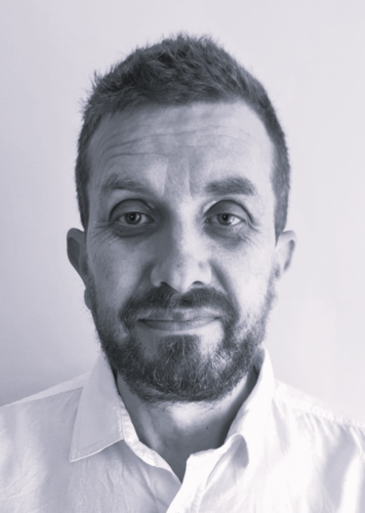
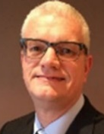


Intro - Our Current Structure
Dominic Bostock
Managing Director
Andy James
Business Director Term Service Contracts
Steve Worthington
Business Director Infrastructure
Ian Bounsall
Business Director Regional Business
Nick Giles
Finance Business Partner
Financial Planning, Reporting & R&O Management
Steve Oakley
Planning, Systems & Process Manager
Central Planning, Systems & Business Processes (inc SHEQ & IMS)
Teleri Kemp
HR Business Partner
Supporting delivery of People Plan
Mark Shopland
H&S Manager
Health, Safety & Environment – Compliance, Competency & Culture
Vacancy
Commercial Director
BD, Work Winning, Contract Commercial Management, R&O
Corserv Corporate Functions: Corporate Finance, HR Ops, Strategic Procurement, IT/Bus. Systems, Legal, & Fleet

Slide 3
Intro – Our Current Business
Cormac
Term Service Business
Andy James
Community Focus
Infrastructure Business
Steve Worthington
Infrastructure for Growth
Regional Business
Ian Bounsall
Commercial Focus
Highways Contract
Environment Contract
Capital Programme Delivery
Consultancy
Civil Engineering Contracting
Design & Build
Infrastructure Projects
Surfacing
External Business & Regional civils
(inc Exeter Depot)
Quarry & Recycling
£140m pa
940 FTE
1,043 H/C
Corserv Solutions Ltd (Teckal Co)
Cormac Contracting Ltd (Trading Co)
£52m £45m £42m (inc intra-company)
470FTE 260FTE 140FTE

Slide 4
Approach
Value
Model
Business Strategy
Business Sustainability & Continuous Improvement
Imperatives
Growth
Values
Governance
Plans & Objectives

Slide 5
Business Strategy
The 3 Principal Objectives of our updated Business Plan and Commercial Strategy are consistent with our existing strategy and our strapline of “Delivering Value for our Communities”:
To create value for Cornwall’s communities through our term service contracts, managing, improving and maintaining highway and environmental assets.
To successfully deliver a programme of public infrastructure for Cornwall’s growth
To grow our regional external business to an enhanced £75m pa by 2029, working towards creating a business of 50:50 council and external revenue
Our revenue and growth will be delivered across 3 strands:
  Council & Inter Company
  Organic external regional Growth
  Strategic Growth
Our external business growth strategy is based on 4 areas:
  Housing & Commercial Infrastructure
  Local Authority & Government Business
  Recycling & Supply
  Utilities & Energy

Slide 6
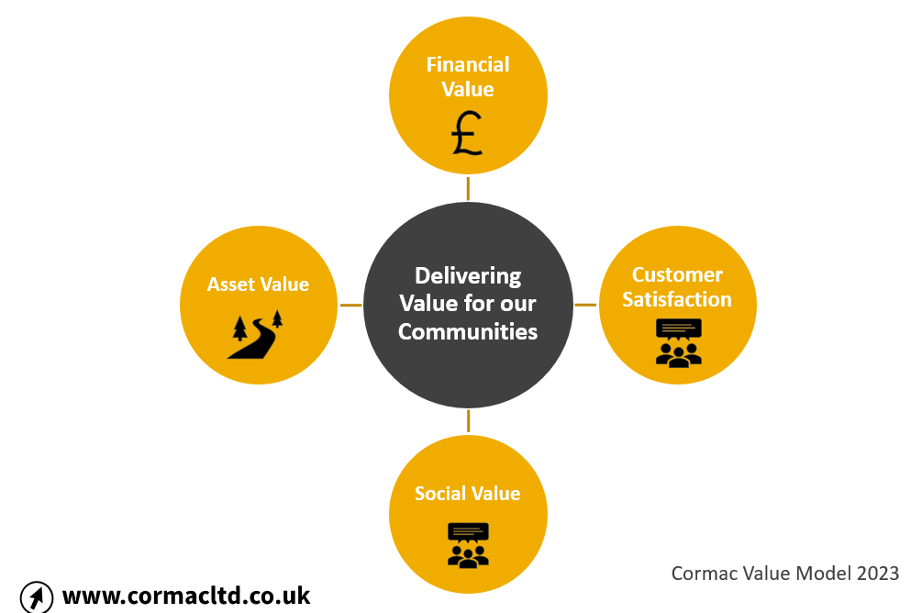
Value Model
Our value model sets out four components of value creation for our shareholder and stakeholders
Financial value: £4.37m net profit in year 1 and £20.8m over the 4-year plan, enabling investment through retained profits and Shareholder Dividend
Social Value: targeting to exceed the £60m pa of social value generated in 2023/24 (equivalent to 41p in every £1). Reducing our carbon in line with our corporate reduction plan.
Customer Satisfaction: continuing our trend of achieving client satisfaction across our council partnerships. Continuing to improve resident satisfaction of the council services we provide, measured through annual resident’s surveys.
Asset Value: optimising asset treatments with available budgets and “Spending money wisely”.

Slide 7



Driving performance & developing culture – Imperatives & Values
Safety First
Collaborative
Investment in People
Trusted
Profitable
Positive
Customer Satisfaction
Innovative
Performance (Imperatives)

Slide 8
Growing the Business
Our plan is based on four themes which we established in 2023 and remain relevant. They develop our diversification from a highways and transportation business into a broader civil engineering and infrastructure, “integrated services” business:
Housing & Commercial Infrastructure: developing our collaboration with tier 2 developers, including Treveth and our growing role at LGV. Delivering further infrastructure at Newquay Airport. Developing our existing collaboration with private sector developers and contractors in assuming that Cornwall’s housing output will double from 2,000 units to 4,000 pa during the plan period.
Local Authority & Government Business: building on existing relationships and frameworks with southwest local authorities, and the Environment Agency. Tracking and positioning ourselves for future opportunities with National Highways (southwest region from 2026). Seeking collaborative opportunities through Local Authority collaboration and combined authority opportunities if they arise.
Recycling & Supply: continue to develop Low Carbon solutions and construction including the development of our recycling business into Devon and proposed Eastern asphalt plant.
Utilities & Energy: building on existing relationships and identified opportunities with asset owners National Grid, South West Water. Continuing to develop our collaboration with Celtic Sea Power Ltd and continuing to grow our expertise and partnerships in utilities planning and coordination, district heating and energy centre infrastructure delivery.

Slide 9
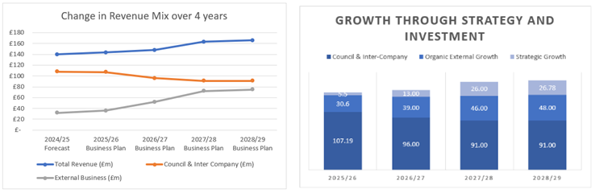
Finance Summary
Our strategy is to create a new revenue mix between council and external business, as shown below, with an anticipation that council revenue will reduce and a strategy to grow external revenue, contributing to a sustainable business.
2025/26 will see a similar level of external revenue and a similar level of council revenue to prior year.
Detail redacted

Slide 10
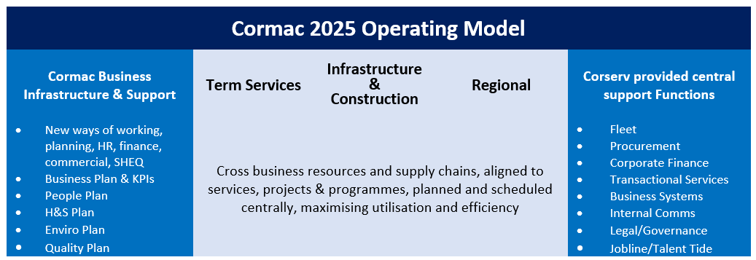
Our 2025 Operating Model
Clearer definition of our three business segments with some reallocations of work creating better alignment and balance.
Appointment of Commercial Director to work across the business
Consultancy led by Business Director Term Services, but central to Infrastructure segment
Utilisation of cross business resources aligned to services, programmes and projects, including management & supervision, operatives, fleet/plant and supply chain, ensuring optimum alignment of cost base with revenue, improving our efficiency and cross business collaboration. This will be administered by our central planning function and development of Total Mobile IT solution.
Implementation and supporting our colleagues to adopt “New Ways of Working” enabled by the Corserv Phase 2 change programme. This will include more efficient system based, lean processes, improved management information to manage performance and risk, maximising use of existing IT systems and Apps to improve our efficiency and performance.
The development of a new Fleet commercial model through collaboration within cross Corserv central functions, in conjunction with a significant fleet renewal programme, which maximises the value of owned fleet, in-house workshops, and fleet management

Slide 11

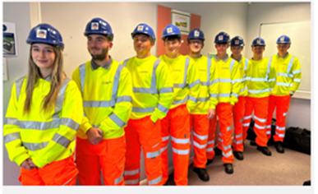
Enabling our Strategy
To support the delivery of our plan and our Continuous Improvement we will seek to continue the Corserv change programme, to support:
        “Great Business Infrastructure” and “New Ways of Working”
        Becoming an “Employer of Choice” and “Career Development Organisation”
        Investment in Business Growth
We have six plans which all contain clear deliverables that will support achievement of objectives:
  People Plan continues to improve our People KPIs, continuing to increase level of employee engagement and performance management through our business imperatives and values including engaging with employees, along with more detailed workforce development planning including succession
  Health, Safety & Wellbeing Plan supports our compliance, continuous improvement and cultural development, ensuring that everyone that works a shift for Cormac returns “home, safe & well” and that we put “Safety First”
  Environment & Sustainability Plan supports improved enviro compliance, delivering opportunities for sustainable construction/services, developing our Social Value, supported by our CREST group and plays a key role in delivering the corporate Corserv Sustainability Strategy inc. Carbon Reduction
  Quality Plan focuses on continuous improvement of our IMS (accredited to ISO 9001, 14001 and 45001) and provides an innovation framework which will play a role in developing future ways of working and further efficiency. A key deliverable of our Quality Plan is the development of an NPS measure
  Business Plan contains our Finance Plan and financial deliverables which are managed through a robust monthly financial reporting process which has become focused on management of Risk and Opportunity
  We are developing an external Communications Plan
Our Risk & Opportunities Procedure will develop our risk management culture
  and is based on the 3 lines of Assurance model

Slide 12
Managing Delivery & Governance
We set objectives which creates accountability within the business, this is being supported by our Plans, and specifically our People Plan.
We have developed a new simplified and objective aligned Performance Review. 98% of colleagues had reviews in Prior Year and we will achieve similar this year
Our steps to promote accountability define what colleagues are accountable for, set and cascade objectives through the business, provide updates monthly with our Tier 4 supported by continuously improving Management Information
Our governance and performance management process is based on the following:
      Delivery and monitoring of our Plans, Projects & Programmes
      Performance & Risk Review (Monthly) – with our Senior Leadership Team
      Cormac Exec Leadership Team (Monthly) – Business Director and MD reports
      Corserv Operational Committee (Monthly)
      Corserv Solutions Ltd Board (Monthly) & ARAC/Remco Committees
      Quarterly COMB (Corserv Contract Oversight & Management Board)
      Quarterly Shareholder Board & Annual Review

Slide 13

Thank you / Meur ras
Delivering Value for our Communities
Collaborative – Innovative – Positive – Trusted

