Slide 1








Ref 395972 • SCS Pay Band 2
Companies House - Chief Executive Officer and Registrar of Companies
for England and Wales
Closing date: 23:55 Sunday 6th April 2025

Slide 2

Contents
  Welcome Message
  About Companies House
  Introduction to Companies House
  Companies House Values
  Key Responsibilities
  Essential Criteria & Salary
  Campaign Timeline
  How to Apply
  Recruitment Process
  Benefits of Working for Companies House
  Diversity and Inclusion
  FAQs
  Contact Us

Slide 3
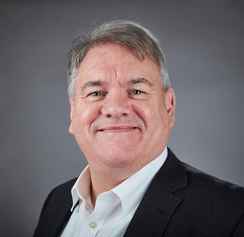
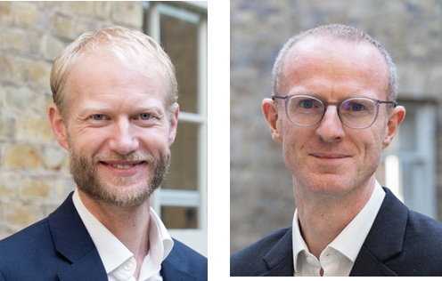
Welcome Message
Companies House is an Executive Agency of the Department for Business and Trade (DBT). As Chief Executive Officer, you will be responsible for providing strategic leadership and direction for the organisation and will work closely with DBT to deliver the policy objectives of Ministers.
We are looking for a visionary leader. Someone with the strategic foresight to shape our direction, and the passion to inspire our talented team. We have ambitious plans for the services we provide to more than 5 million companies in the UK and to the millions of users of our data. As we transform, we’ll continue to work alongside other government departments to play our part in the battle against economic crime.
Our people at the heart of everything we’re aiming to achieve. As CEO, you’ll be committed to our culture of empowerment which allows our brilliant people to deliver brilliant services. You’ll be an inspiring and natural leader, with a collaborative approach to your work and an exceptional ability to develop effective working relationships.
This is an incredible opportunity to make a lasting impact to a long-established, well recognised and highly regarded organisation.
​
An ambitious programme of transformation is underway (the most significant reforms since it was established in the 19th Century) which will fundamentally reshape what Companies House does – changing the culture of the organisation to deliver the aims of the Economic Crime and Corporate Transparency Act 2023 and playing a key role in combating economic crime. This is a key leadership role, leading and managing organisational change and transformation, tackling economic crime and developing and introducing the organisation’s strategic plan.
​
If you are successful, you'll join a team of professional, expert and committed people motivated by public service and working collaboratively. You'll represent Companies House at the most senior levels with Ministers, Government departments and other stakeholders.
​
We strongly welcome applications from candidates from all backgrounds, with different experiences and perspectives.
Companies House is a fantastic place to work, with wide ranging responsibilities across the economy that provide the opportunity to make a positive difference to businesses and support economic growth.
This is an exciting time for Companies House – an organisation that already processes millions of transactions a year and which handled over 16 billion requests for its data last year.
As the Chair of Companies House, I am proud to lead a high performing organisation built on a foundation of innovation and excellence, with an ambition to be the most trusted, open and innovative register in the world. Today, we stand at a pivotal moment in our journey as we finalise our new strategy, setting the direction for the organisation as we fundamentally transform what we do and how we do it, and deliver on the biggest reforms to company law in 180 years.
John Clarke
Chair of Companies
House
Caleb Deeks &​ Gavin Lambert ​
Directors General, DBT
(Hiring Managers)

Slide 4

Companies House​
What we do?
Companies House plays a critical role in the UK economy, helping to make it a great place to start and run a business. The data on our register on UK companies, their directors and their accounts informs business decisions, drives corporate transparency and supports economic growth. The Economic Crime and Corporate Transparency Act 2023 has further empowered Companies House to play a significant role in the fight against economic crime, in their most ambitious reform programme since being established in 1844. Companies House handled over 1.5 million incorporations and dissolutions last financial year and the value of the register to UK businesses has been estimated to be up to £3bn annually.
What are we looking for?
We are looking for someone with the experience of leading and delivering genuinely transformational change; someone who can reach out and build new partnerships in the public and private sector; someone who can support and challenge the organisation as it seeks to deliver this change; and someone who can ensure throughout this change that Companies House continues to provide excellent service to the 5 million companies on the register.

Slide 5

Introduction to Companies House
This is an exciting time to join Companies House as we are undergoing the biggest reform programme since Companies House was established in the 19th Century, which will fundamentally transform what we do and how we do it. In 2023 the UK Government passed the Economic Crime and Corporate Transparency Act, which sought to ensure that Companies House is fully equipped with the powers we need to tackle misuse of the companies register and to support the Government’s fight against economic crime. This is a significant expansion of the role of Companies House, and we are making a reality of new powers to maintain the integrity of the register, introducing new processes to verify the identity of directors on the register and developing new capabilities to identify and tackle economic crime on the register.
In parallel we are in the process of modernising our underlying systems and processes, ensuring we can leverage the full use of digital tools and cutting age data analytics to maximise the value of the data on our register and to strengthen our ability to deliver both our core services and our new powers.
Taken together, this is a substantial and far-reaching reform programme which will enable Companies House to play a leading role in the fight against corrupt business practices, providing the transparency and clarity necessary for the UK to continue to be regarded as a world-leading place to do business.
These changes will have an impact on our systems, services, culture and ways of working, and we are looking for someone experienced to lead the organisation through this next phase of transformation, ensuring that our organisation not only meets the challenges of today but is also well-prepared for the future. This journey requires expertise and experience in leading a complex change agenda, the delivery of multiple programmes and the creation of significant new value.

Slide 6
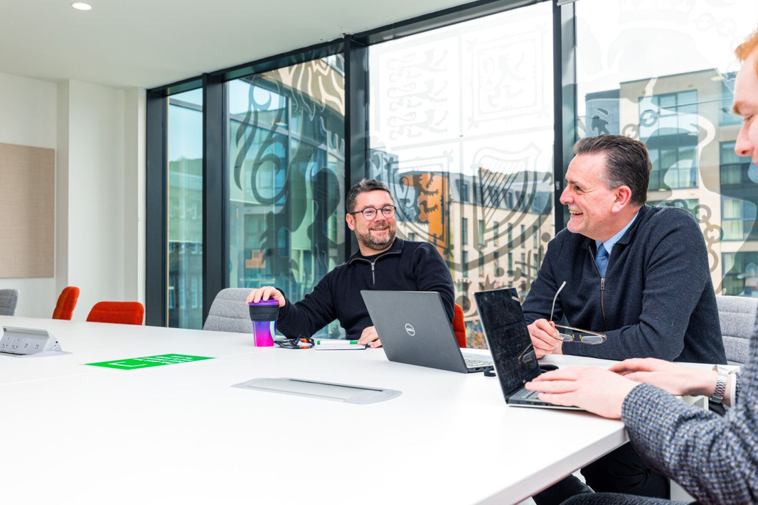
Companies House Values​
To support our culture of enabling our brilliant people to flourish and drive high performance, we’ve adopted the following:
ABC behaviours: Adaptable, Bold and Curious.
Our behaviours are an important part of working at Companies House. They underpin what we do and how we do it – setting out the way we should behave, and the behaviours we can expect from our colleagues.
Our behaviours help us to deliver on our values:
Working as one
Every achievement counts
Excellent standards and behaviour
They also drive us to meet our strategic goals and are underpinned by a commitment to EDI and the recognition that every single person in Companies House has an important role to play in living our behaviours and values.
As an organisation, we recognise that EDI is about tackling under-representation, building inclusive cultures, and ensuring system accountability for progress. It’s also about creating and implementing evidence based, innovative approaches that drive change.
We’re committed to creating an environment that ensures everyone can reach their full potential, and that diversity of thought and experience is integral to inclusive policy making and delivering excellent public services.
Our organisation is transforming, and our current values and behaviours have served us well. To ensure that we're setting ourselves up for the future, we're conducting an organisation wide review of our culture to deepen our understanding of the aspects of our culture that we want to cherish, and where we need to evolve in response to our changing organisation. This is an exciting time to join us as we shape our future.

Slide 7
Key Responsibilities
As CEO of Companies House, you will be instrumental in guiding the organisation through the period of significant change, fostering a culture of innovation and excellence, and ultimately helping Companies House to achieve its mission of enhancing corporate transparency and combating economic crime. Your key responsibilities will include:
Provide strategic leadership and direction to Companies House, ensuring the delivery of its statutory functions, services and transformation programme, with a strong emphasis on the critical importance of people and culture to Companies House’s success.
Acting as Registrar of Companies for England and Wales. Working in close collaboration with the Registrars for Scotland and Northern Ireland you will be responsible for meeting the Registrars' objectives as set out in the Economic Crime and Corporate Transparency Act 2023.
Lead the development and implementation of the organisation's strategic plan, aligning it with government priorities and stakeholder expectations.
Create an environment that supports the delivery of multiple programmes and establishes many of the best practices found in leading edge data and service companies. Fostering a culture of innovation, continuous improvement and customer focus within the organisation.
Managing the pivot towards a more customer, data and analytics centric ecosystem, and influencing industry ecosystems in creating greater trust in the integrity of the register.
Foster a collaborative and transparent relationship with non-executive directors and the Department for Business and Trade, ensuring their insights and expertise are effectively integrated into the strategic decision-making process.
Oversee the management of the organisation, driving increasing levels of performance while ensuring that efficiencies are identified and realised.
Represent Companies House at the most senior levels with Ministers, government departments, industry bodies, and other stakeholders. Acting as the Accounting Officer of the organisation and appearing before Parliament to account for the organisation's spend and performance.

Slide 8


Essential Criteria
Significant senior leadership experience, demonstrating a strong commitment to public service values, integrity, and ethical conduct, with expertise in the public sector, regulatory bodies, or a comparable private sector environment.
Demonstrated ability to lead and manage organisational change and transformation, including complex technical, analytical, and service programmes, ensuring operational resilience and maximising the value of data and insight.
Strong strategic thinking and planning skills, with the ability to translate vision into actionable plans while ensuring alignment with corporate governance, regulatory frameworks, and compliance requirements.
Excellent communication and interpersonal skills, demonstrating the ability to build trusting relationships and gain the confidence of a wide range of stakeholders.
Evidence of strong financial acumen and experience of managing a significant budget to drive efficiencies and resources effectively.
Salary, SCS2
£98,000 - £120,000
This role has a minimum assignment duration of 3 years. This is an expectation only; it is not something which is written into your terms and conditions or indeed which the employing organisation or you are bound by. ​
Standard Civil Service pay principles apply to existing civil servants: Those applying on promotion will receive either a 10% increase of their current basic salary or the pay band minimum (whichever is greater), for those applying on level transfer, there would be no salary uplift, in line with Civil Service pay rules.
This role is based in Cardiff with a hybrid working model, dependent upon business needs. Relocation costs will not be reimbursed.

Slide 9





Indicative Timeline​
Selection Panel
The panel will be chaired by Atul Devani, Civil Service Commissioner and will include:
Gavin Lambert/Caleb Deeks, Directors General, DBT
John Clarke, Chair of Companies House
Tara Smith, Chief Operating Officer, DBT
(In exceptional circumstances it may be necessary to alter the membership of the panel, if this happens you will be informed at the earliest opportunity)
We will try and offer flexibility, if necessary, but it may not be possible to offer alternative dates for assessments or interviews. You are therefore expected to note the below timetable, exercising flexibility through the recruitment and selection process, in order to meet the dates given. Please note that these dates may be subject to change.​
The anticipated timetable is as follows:
23:55 Sunday 6 April 2025
w/c 12th & w/c w/c 19th May
w/c 14 April
w/c 05 May
w/c 26th May
Deadline for applications​
Longlist results expected by
Shortlist results expected by
Assessments
Interviews
Please note:​
Assessments and interviews are normally conducted during UK business hours. If you are currently based in a different time zone to the role you are applying for, we will try to accommodate this but please be aware that you may need to conduct your assessments and/or interview during unsocial hours.​

Slide 10


How to Apply
How to apply​​
Hays, an Executive Search firm, have been appointed to assist with this recruitment campaign. To apply for this post, you will need to submit documentation below via the following link, by no later than 23:55pm on Sunday 6th April.
Follow this link to apply: Companies House - Apply for vacancies - Find a job, build a career | Hays
If you have any issues accessing the link or questions regarding the documentation, please contact:​
Andrew Timlin: 07887777735, Andrew.Timlin@hays.com
Owen Quant: Owen.quant@hays.com
Documentation:​
A CV setting out your career history, with key responsibilities and achievements. Please ensure you have provided reasons for any gaps within the last two years.​
2. A Supporting Statement of around two pages of A4 explaining how you meet the requirements of the person specification as far as you are able to.​
Failure to submit both documents will mean the panel only have limited information on which to assess your application against the criteria in the person specification. Please ensure that both documents contain your full name.
Your Supporting Statement
This is your opportunity to give examples and show how your skills and experience fit the job requirements.
When writing a supporting statement, it is important that you:
  Read the job specification so you are clear about the job requirements. Structure your personal statement to reflect the essential criteria listed in the advert.
  Make sure you provide evidence against each of the listed criteria - i.e. ‘experienced in leading high performing and diverse teams and promoting inclusivity.’ When have you led a team, how large, what did you do to promote inclusivity, how did you handle diversity?
  Ensure any evidence you provide demonstrates the impact and result of your actions in that situation, provide statistical evidence where relevant.
For more information click here

Slide 11

Recruitment Process
Longlist
Longlisting is made on the basis of merit, following the closure of the advert, the panel will assess the evidence presented by all applicants against the advertised essential criteria. The highest rated applicants will be invited to a pre-liminary interview with Hays.
Shortlist​
Shortlisting for interview is made on the basis of merit. The selection panel will assess the evidence presented by all applicants against the advertised essential criteria and the highest rated applicants will be invited to interview.
Assessments
If you are shortlisted, you will be asked to take part in a series of assessments which will include psychometric tests and a staff engagement exercise. These assessments will not result in a pass or fail decision. Rather, they are designed to support the panel’s decision making and highlight areas for the panel to explore further at interview.
Further details on what the assessments will entail, can be found here:
www.scs-assessments.co.uk. Full details of the assessment process will be provided to shortlisted candidates at the earliest opportunity.
You will also have the opportunity to speak to John Clarke (Chair of Companies House) prior to the final interview to learn more about the role and the organisation. Please note this is not part of the formal assessment process.
Interview
Shortlisted candidates will be asked to attend a panel interview in order to have a more in-depth discussion of your previous experience and professional competence in relation to the criteria set out in the essential criteria.
As part of the interview, you may be asked to prepare and present a short presentation, you will be advised of the presentation topic in the interview invitation.
Selection and Feedback
Regardless of the outcome, we will notify all candidates as soon as possible. We will send you a copy of any report for any assessment that you may have undergone as part of the recruitment process.
Feedback will only be provided to candidates who reached interview.
Reserve List
If we receive more applications from suitable candidates than we have vacancies at this time, we may hold suitable applicants on a reserve list for 12 months, and future vacancies requiring the same skills and experience could be offered to candidates on the reserve list without a new competition. We will contact you to confirm if your application is to be held on a reserve list.
Diversity Monitoring
As part of the online application process, you will be asked a number of diversity-related questions. If you do not wish to provide a declaration on any of the particular characteristics, you will have the option to select 'prefer not to say'. The information you provide when submitting your application will help us monitor our progress towards the Civil Service becoming the most inclusive employer.

Slide 12


Benefits of Working for Companies House​
Companies House is a rewarding place to work. Benefits include:​
Generous annual leave and bank holiday allowance
A competitive contributory pension scheme (c 30% employer contribution)
With competitive maternity, paternity and parental leave we also recognise the importance of a good work-life balance and offer flexible working and a family friendly approach to work
A number of inclusive network groups to support our colleagues and a great sports and social society
Staff discount scheme
3 days paid volunteering leave
Occupational sick pay
A range of work-based training and qualifications, coaching, and mentoring opportunities, and a guaranteed five days of learning a year
Pension:
Your pension is a valuable part of your total reward package where the employer makes a significant contribution to the cost of your pension.
Your contributions come out of your salary before any tax is taken. This means, if you pay tax, your take-home pay will not be reduced by the full amount of your contribution; and your pension will continue to provide valuable benefits for you and your family if you are too ill to continue to work or die before you retire. For more information, visit:
www.civilservicepensionscheme.org.uk

Slide 13

Equality, Diversity and Inclusion in Companies House
We are committed to inclusive and diverse leadership, and we welcome applications from under-represented groups and those based across the whole of the UK.
To learn more please see the Civil Service People Plan and Civil Service D&I Strategy.
In our Strategy we share our vision as being, 'To be a leading Civil Service department and model employer where our commitment to Equality, Diversity and Inclusion supports our brilliant people to deliver brilliant services' Companies House is an equal opportunities employer. We provide equality of opportunities, are representative of the citizens that we serve and have an inclusive culture which ensures everyone can bring their whole and brilliant selves to work.
Equality, diversity and inclusion (EDI) for our people is the golden thread that shapes everything we do and runs throughout our five year strategy (2020-25).
Reasonable Adjustments
The Department is recognised as a Disability Confident Leader. Please follow this link for information.
We are committed to attracting, recruiting and retaining disabled people and supporting them in achieving their full potential.
If you need a change, or what we call a reasonable adjustment, to be made so that
you can make your application, you should contact Andrew.timlin@hays.com or Owen.quant@hays.com as soon as possible before the closing date to discuss your needs.
Furthermore, we are also able to offer reasonable adjustments throughout the recruitment process at assessment and interview stage. For example, this may be a consideration around wheelchair access at interview, or adjustments for neurodiversity (e.g. ADHD, autism, dyslexia or dyspraxia) when extra time can be offered for written tests or alterations to the environment in which you’re interviewed.

Slide 14

FAQs
1. Can I apply if not currently a Civil Servant?​
Yes. This role is open to suitably qualified people in the external market and to existing civil servants and those in accredited Non-Departmental Bodies.​
2. Is this role suitable for part-time working?​
No, this role is available for full-time, or flexible working arrangements. If you wish to discuss your needs in more detail, please get in touch.
3. Will the role involve travel?​​
Yes, you will be primarily based in Cardiff, with regular travel throughout the UK required.
4. Where will the role based?​
If successful you will be based in Cardiff, Wales
5. Can I claim back any expenses incurred during the recruitment process?​
No, unfortunately we will not be able to reimburse you, except in exceptional circumstances and only when agreed in advance.
6. What do I do if I want to make a complaint?​
The law requires that selection for appointment to the Civil Service is on merit on the basis of fair and open competition as outlined in the Civil Service Commission’s Recruitment Principles.
If you feel your application has not been treated in accordance with the Recruitment Principles and you wish to make a complaint, you should contact Georgia Defoe SCSrecruitment@businessandtrade.gov.uk in the first instance.
If you are not satisfied with the response you receive from the Department, you can contact the Civil Service Commission at: https://civilservicecommission.independent.gov.uk/contact-us/
7. What should I do if I think I have a conflict of interest?
Candidates must note the requirement to declare any interests that might cause questions to be raised about their approach to the business of the Department. If you believe that you may have a conflict of interest, please contact Andrew Timlin, Andrew.timlin@hays.com or Owen Quant, Owen.quant@hays.com before submitting your application.

Slide 15
FAQs
8. Security Clearance and eligibility:
This role currently requires Security Clearance (SC) and you must hold or be prepared to undertake clearance to this level ahead of your start in the position.
The successful candidate should also be willing to obtain Developed Vetting (DV) clearance in the future should it be required.
9. What nationality do I need to hold in order to apply?​​
The following groups are broadly eligible to apply:​
UK nationals​​
Nationals of the Republic of Ireland​​
Nationals of Commonwealth countries*​​
Nationals from the European Union (EU), European Economic Area (EEA) or Switzerland with (or eligible for) status under the European Union Settlement Scheme (EUSS).​​
Relevant EU, EEA, Swiss or Turkish nationals working the Civil Service​​
Relevant EU, EEA, Swiss of Turkish nationals who have built up the right to work in the Civil Service​​
Certain family members of the relevant EU, EEA, Switzerland and Turkish nationals​​
For further information on whether you are eligible to apply, please visit GOV.uk.​​
The qualifying criteria needed
to apply for ﻿SC:​
A resident in the UK for three out of the last five years immediately prior to your application. Please note: at least one year of this must have been a consecutive twelve-month period, unless you have served overseas with HM Forces, or in some other official capacity as a representative of His Majesty’s Government, or have lived overseas as a result of your parent’s or partner’s Government employment.​

Slide 16


Thank You
If you wish to discuss the role in more detail before submitting an application, please contact Hays Executive on:
Our work is governed by the Civil Service Commission
Andrew.Timlin@hays.com ​

